Slide 1
Alexa Lab
Giuliano Tortoreto

Slide 2
What is Alexa and Skills
Alexa
Amazon Personal Assistant
Cloud-based voice service
Skills
Make Alexa smarter, tasks faster, easier, and more delightful for customers
Alexa Skills Kit

Slide 3
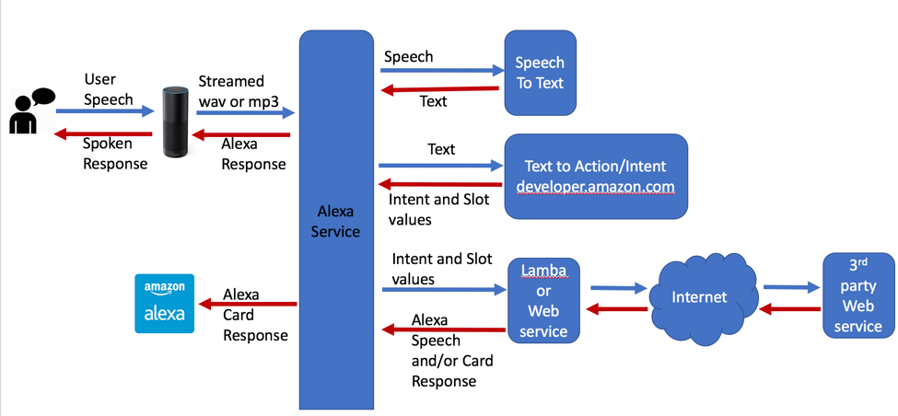
Alexa Skills Architecture
*from https://medium.com/@abraham.kang/understanding-the-differences-between-alexa-api-ai-wit-ai-and-luis-cortana-2404ece0977c

Slide 4
What does it mean to build an Alexa Skill?

Slide 5
Outline
How to build an Alexa Skill and Intent Schema Customisation
Alexa Skill Integration
Slot Customisation
Context Management
NLG Customisation
Multimodality

Slide 6
How to build an Alexa Skill

Slide 7
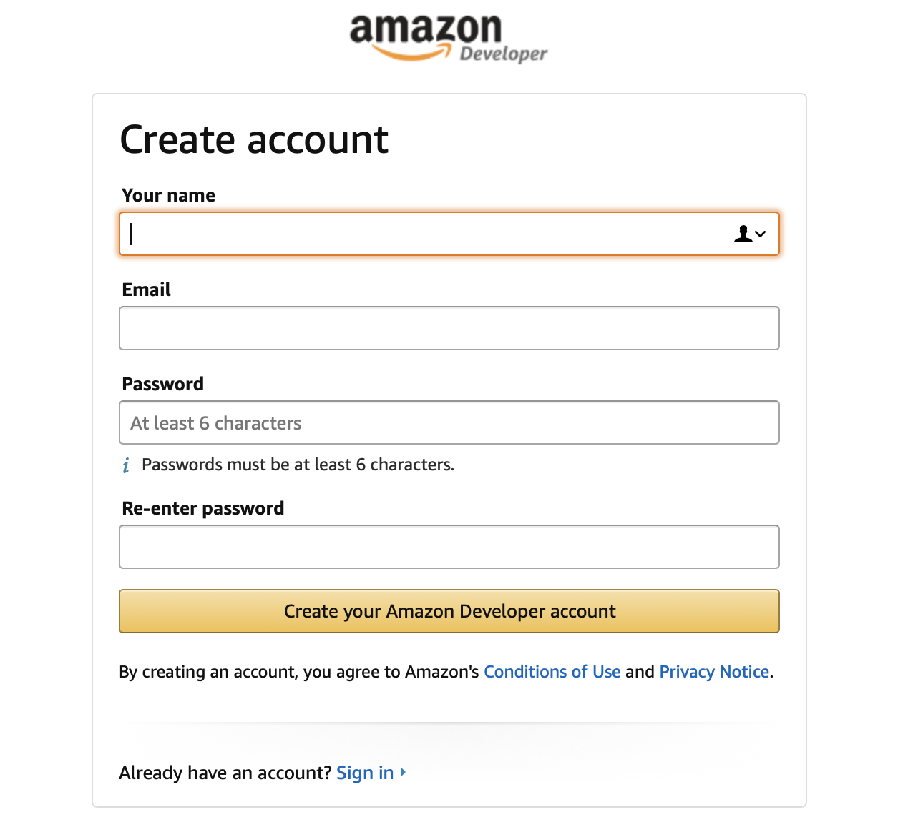
How to build an Alexa Skill
Create an account: https://developer.amazon.com/it/alexa-skills-kit

Slide 8
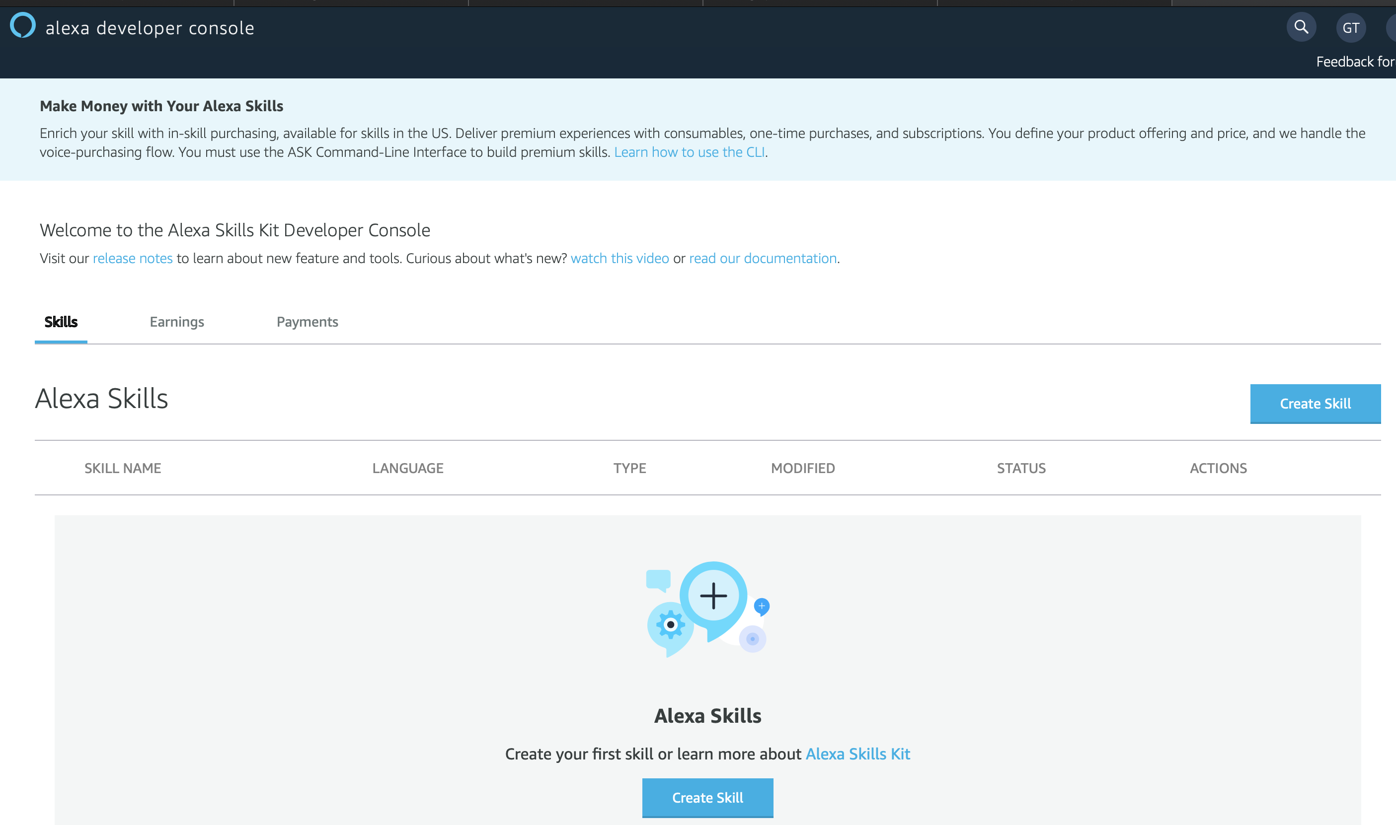
Go to Alexa Console

Slide 9
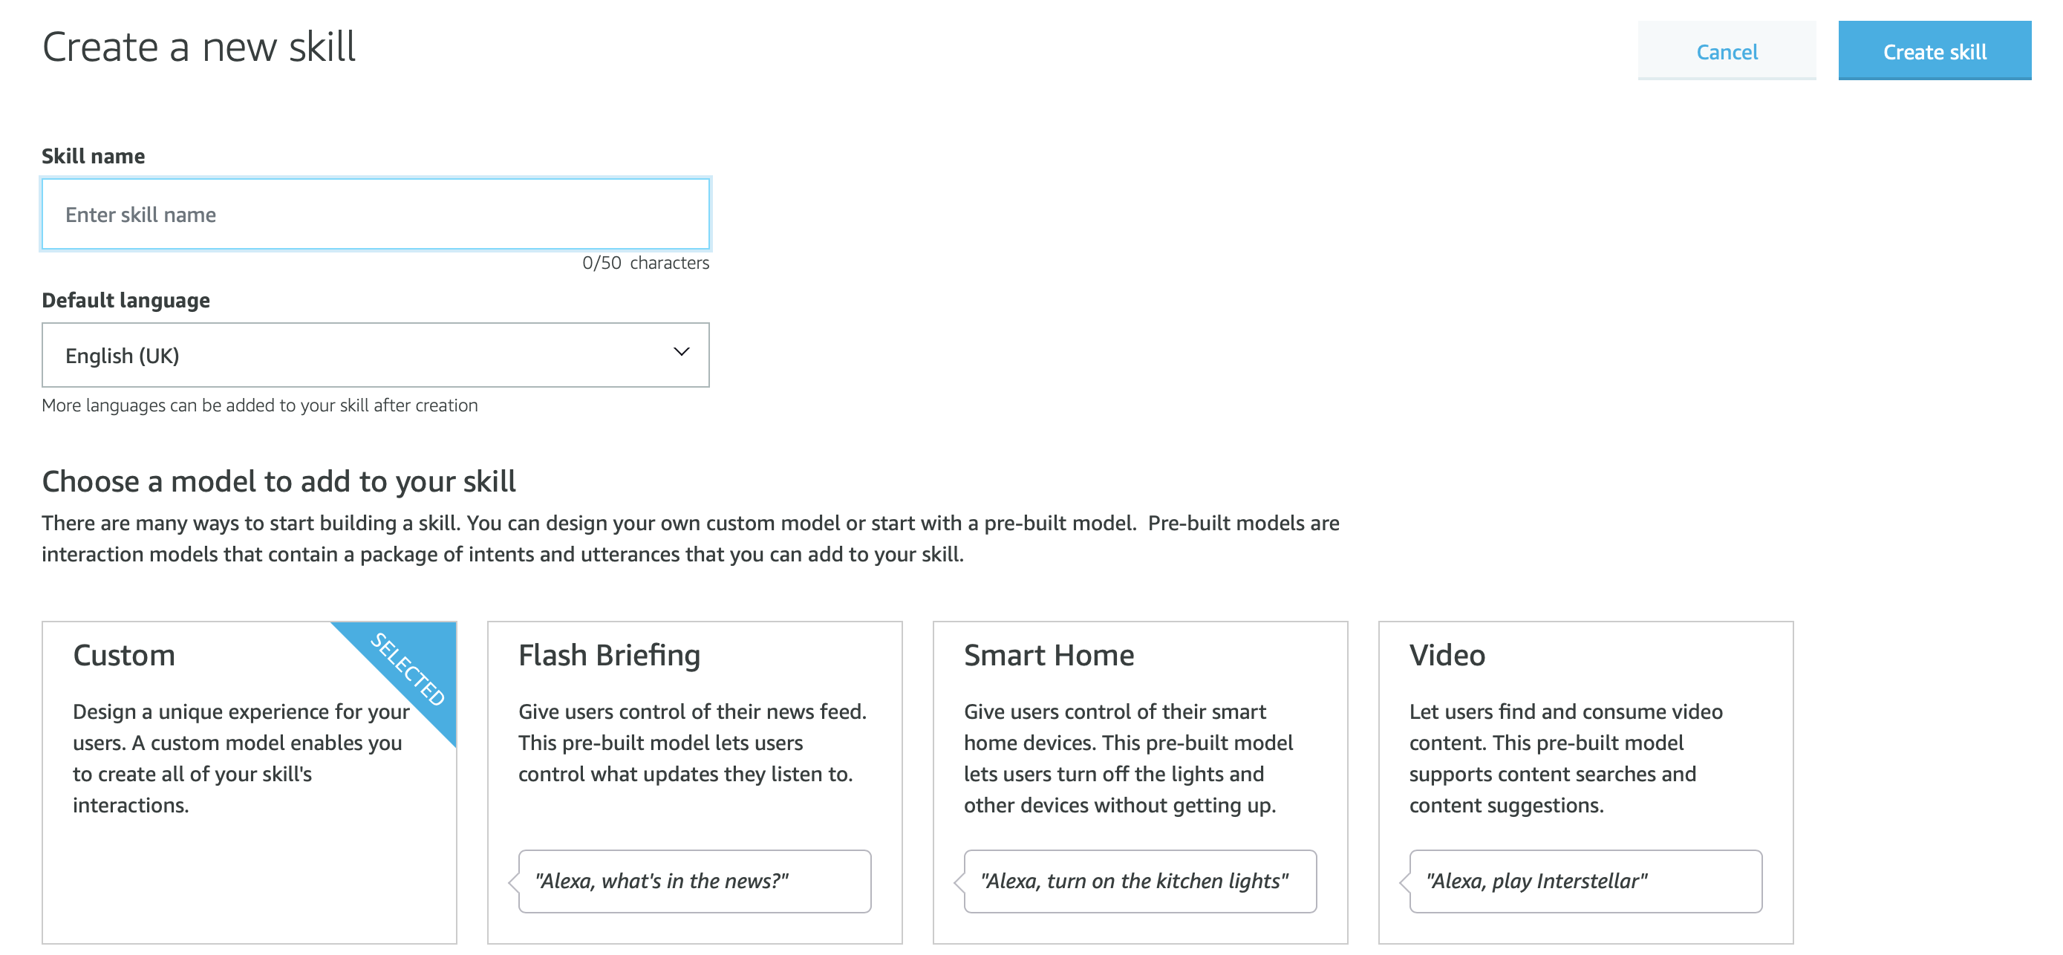
Create A Skill

Slide 10
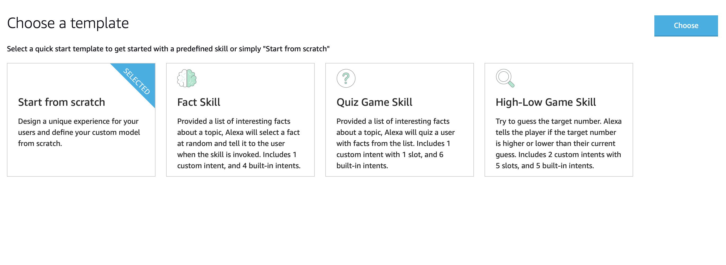
Create A Skill (2)

Slide 11
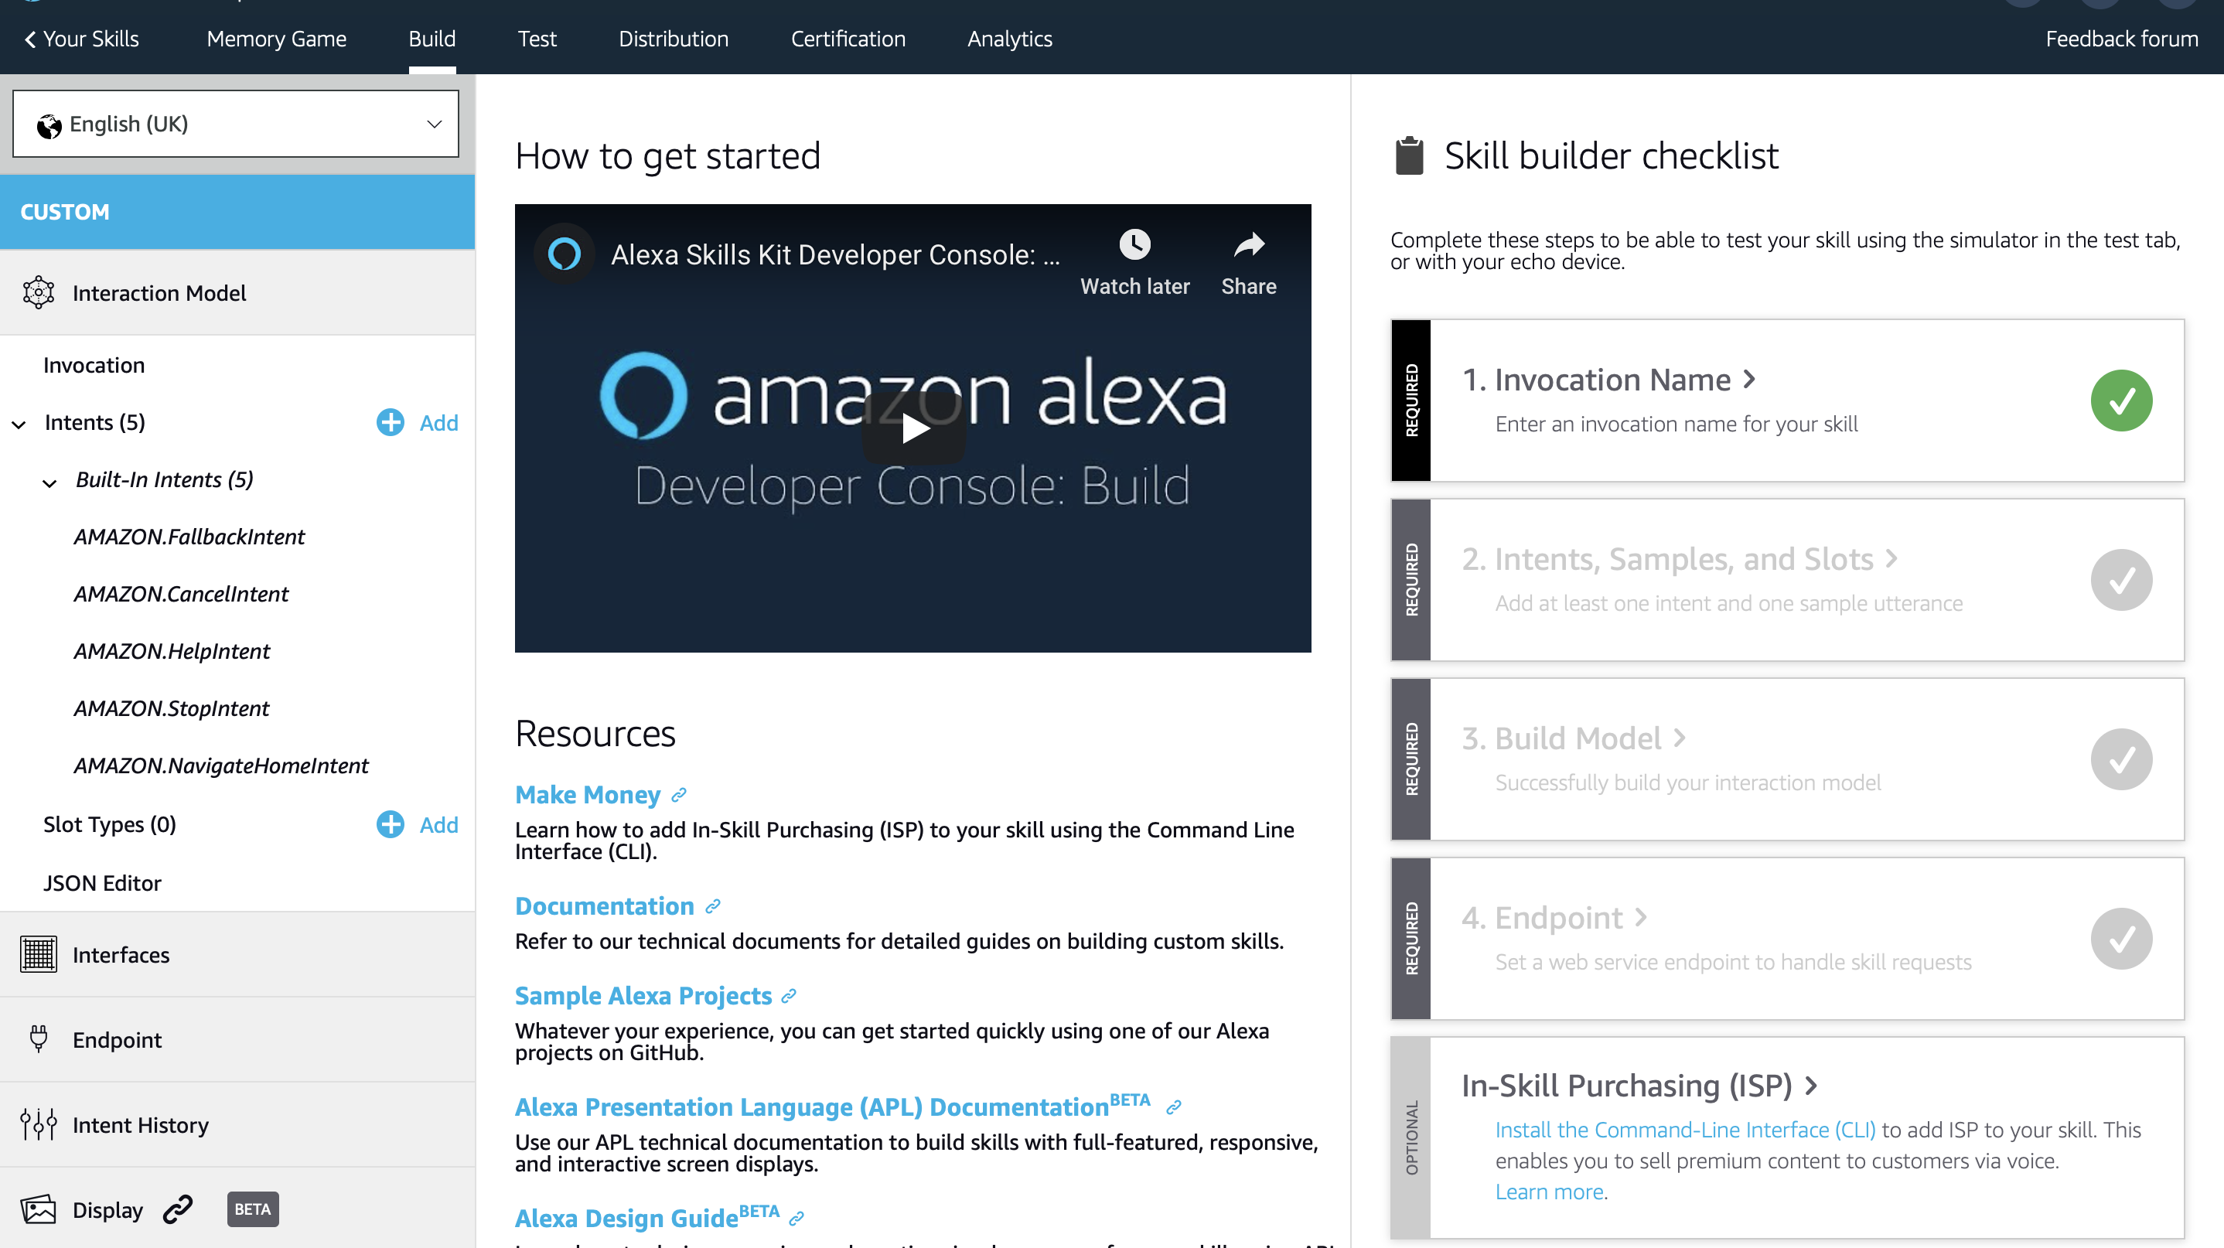
Create A Skill (3)

Slide 12
What do you need
Fork https://github.com/giTorto/alexa_lab.git
Clone on your machine
3 main code examples
Basic
Context and customised Slots
Multimodality

Slide 13
Basic Intent Schema

Slide 14
What Alexa Provides
Default Intents
Fallback Intent
Cancel Intent
Help Intent
Stop Intent
NavigateHome Intent
Default Slots
Numbers, Dates, and Times
Date
Duration
…
Phrases
SearchQuery
List Types
Actor
AggregateRating
…
Full list here

Slide 15
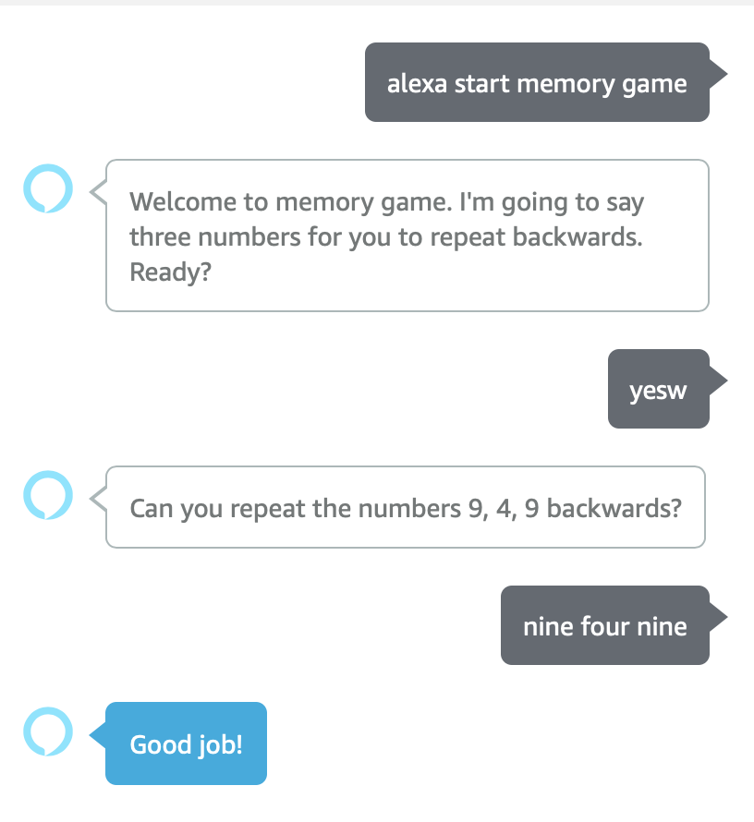
Our First Skill

Slide 16
Upload the custom intent schema
Copy from https://github.com/giTorto/alexa_lab/blob/master/pt1_basic_skill/alexa_skill_config/intent_schema.json
Paste in the json editor the content:
2 intents are added: AnswerIntent and YesIntent
Or use the UI

Slide 17
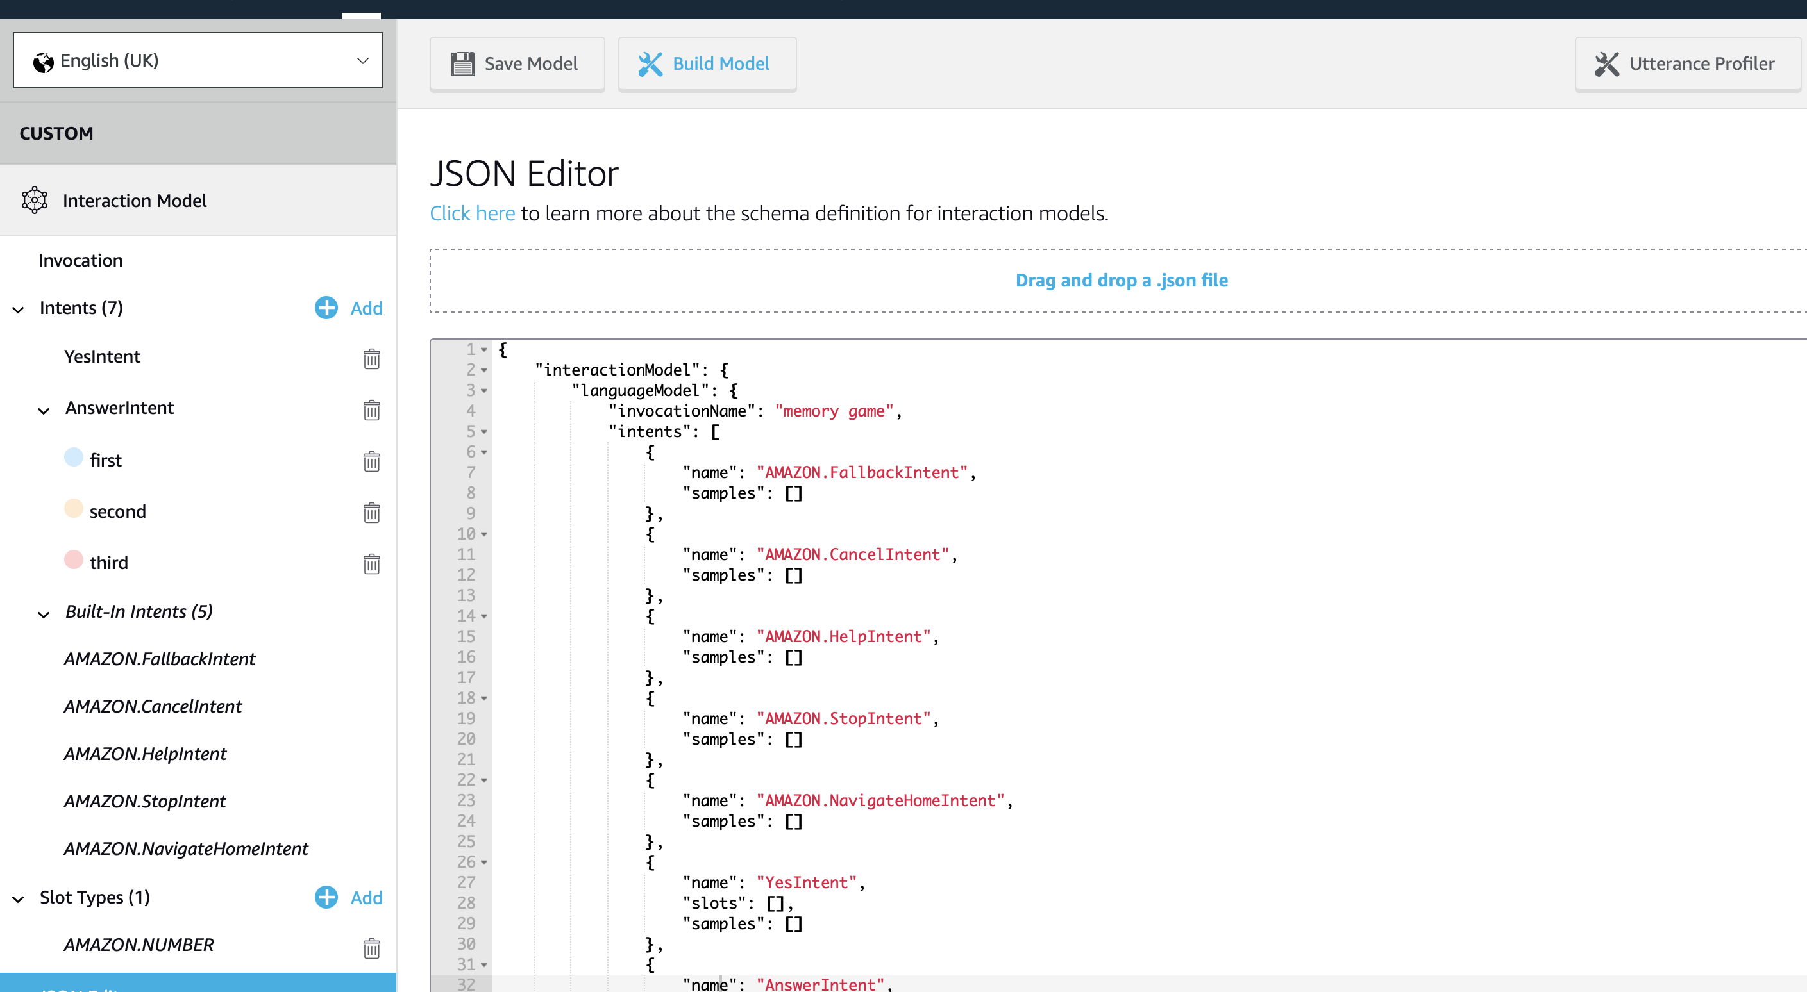
Create A Skill (4): Basic Intent Schema

Slide 18
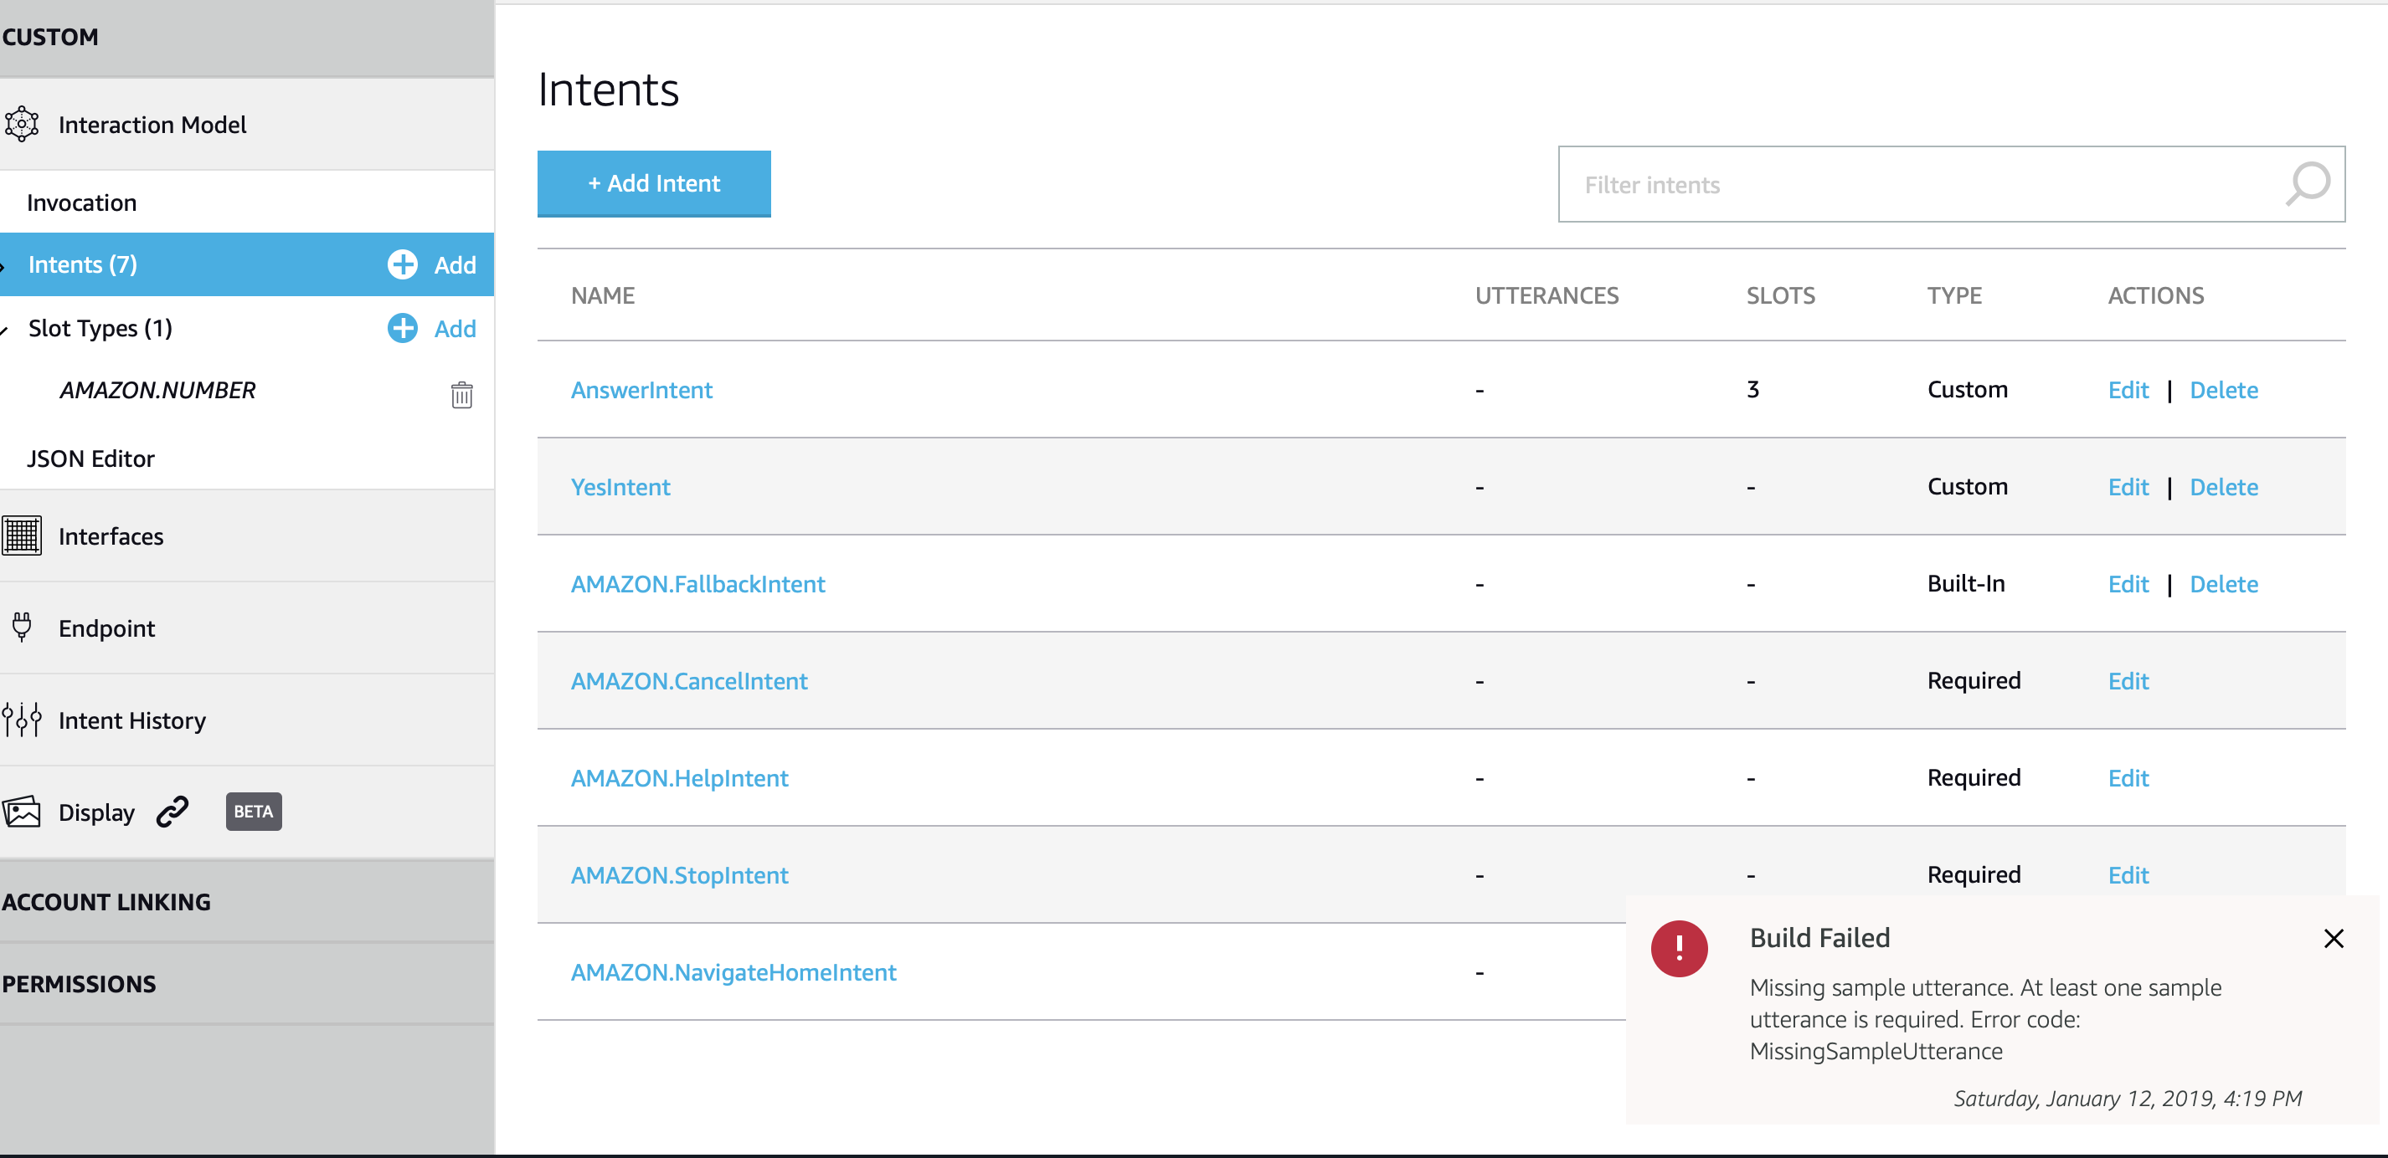
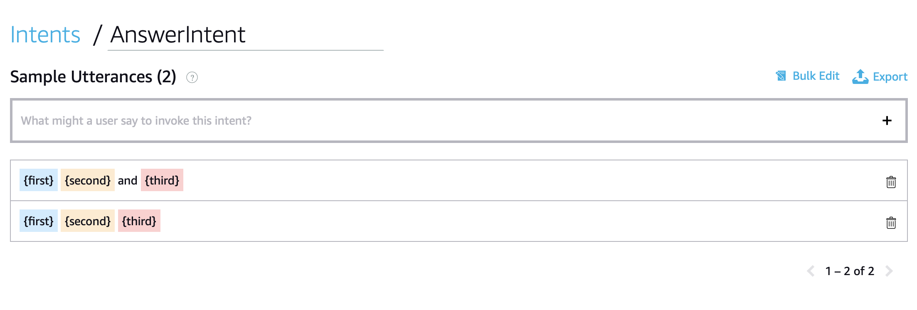
UI way
Annotated as AMAZON.Number

Slide 19
Save Model

Slide 20
Build Model

Slide 21
Alexa Skill Integration

Slide 22
Alexa Skill Integration
So far we just modified the NLU
Now we need a DM and a web service
For now let’s see how to run code locally

Slide 23
Flask-ask
https://flask-ask.readthedocs.io/en/latest/
Has decorators to map Alexa requests and intent slots to view functions
Helps construct ask and tell responses, reprompts and cards
Makes session management easy
Allows for the separation of code and speech through Jinja templates
Verifies Alexa request signatures

Slide 24
Running Alexa Skill Flask Webserver
Install Dependencies and code
virtualenv -p python3.6 alexa_lab_venv source /home/giulianTrt/alexa_lab_venv/bin/activate pip install flask-ask
pip install cryptography==2.1.4 git clone https://github.com/giTorto/alexa_lab.git
Move to pt1_basic_skill
python alexa_app.py
You will have a Flask web server listening
Based on Flask-ask
*pip install git+https://github.com/johnwheeler/flask-ask.git

Slide 25
Integrating with ASK connection
ASK requires HTTPS connection
Local testing: ngrok
https://ngrok.com/download, blocked by UNITN Proxy
Deploy: pythonanywhere
https://www.pythonanywhere.com
Free and provides 1 free hostname
Ngrok:
Public URLs for building webhook integrations.
Pythonanywhere:
Free Python server hosting

Slide 26
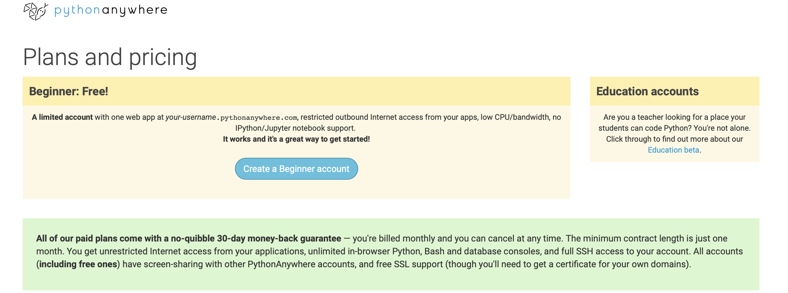
Pythonanywhere
Develop and host your website or any other code directly from your browser without having to install software or manage your own server
Create an account

Slide 27
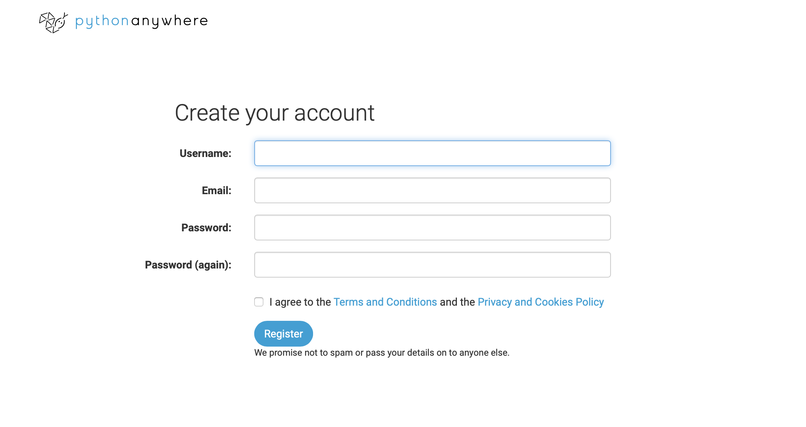
Pythonanywhere: Account Creation

Slide 28
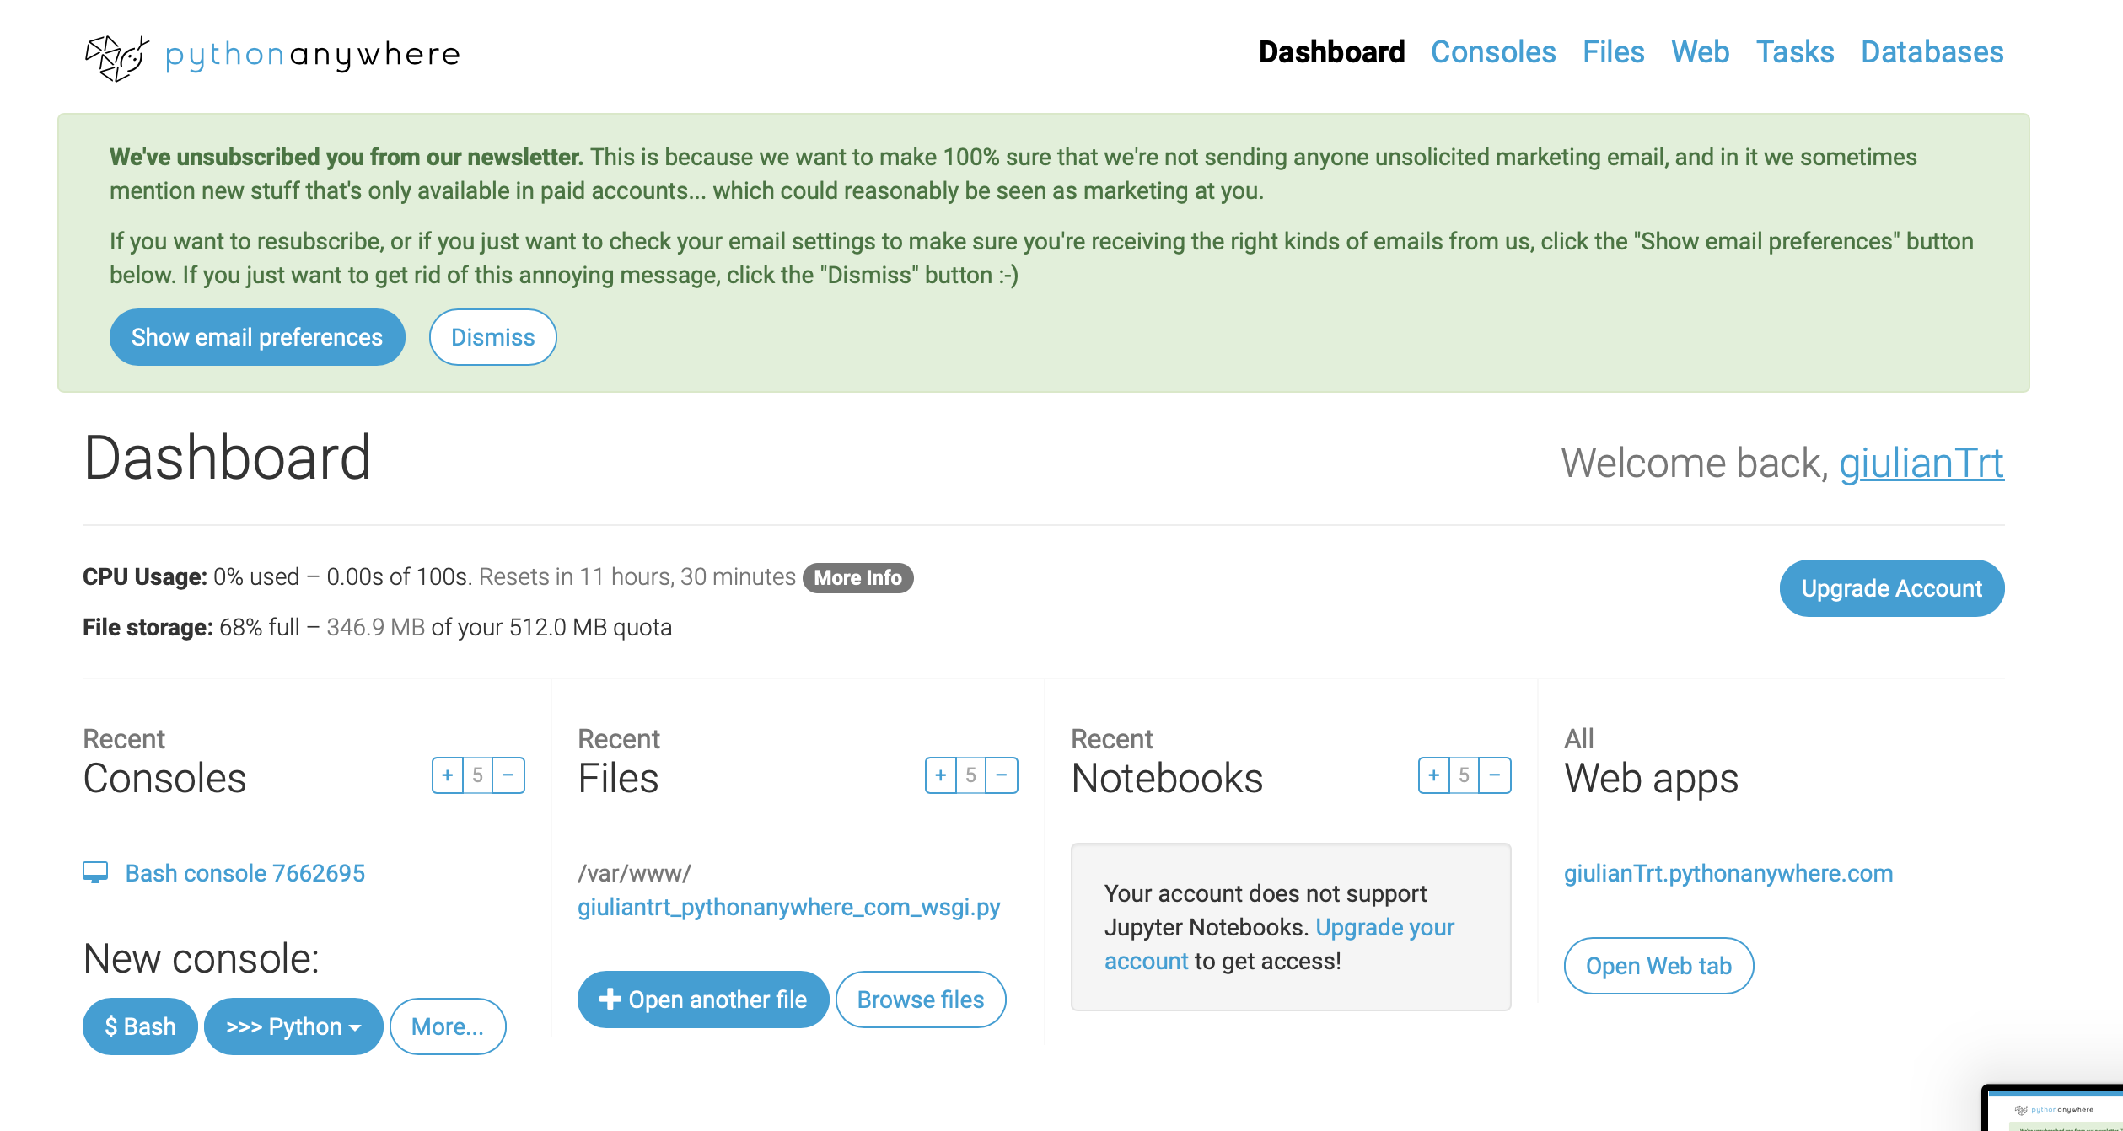
PythonAnywhere dashboard

Slide 29
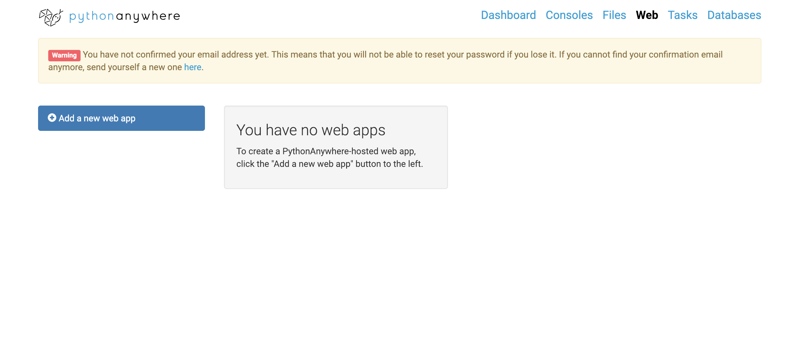
PythonAnywhere: App Creation

Slide 30
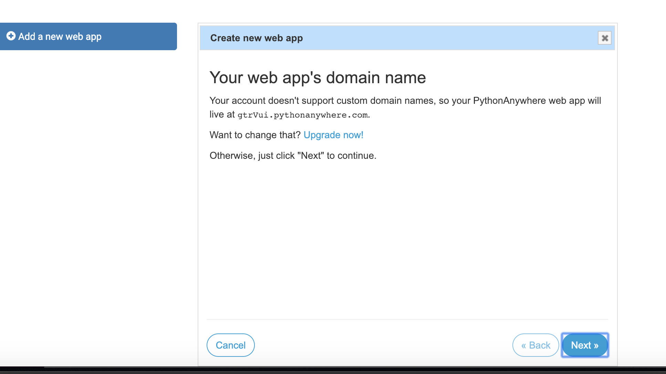
PythonAnywhere: App Creation

Slide 31
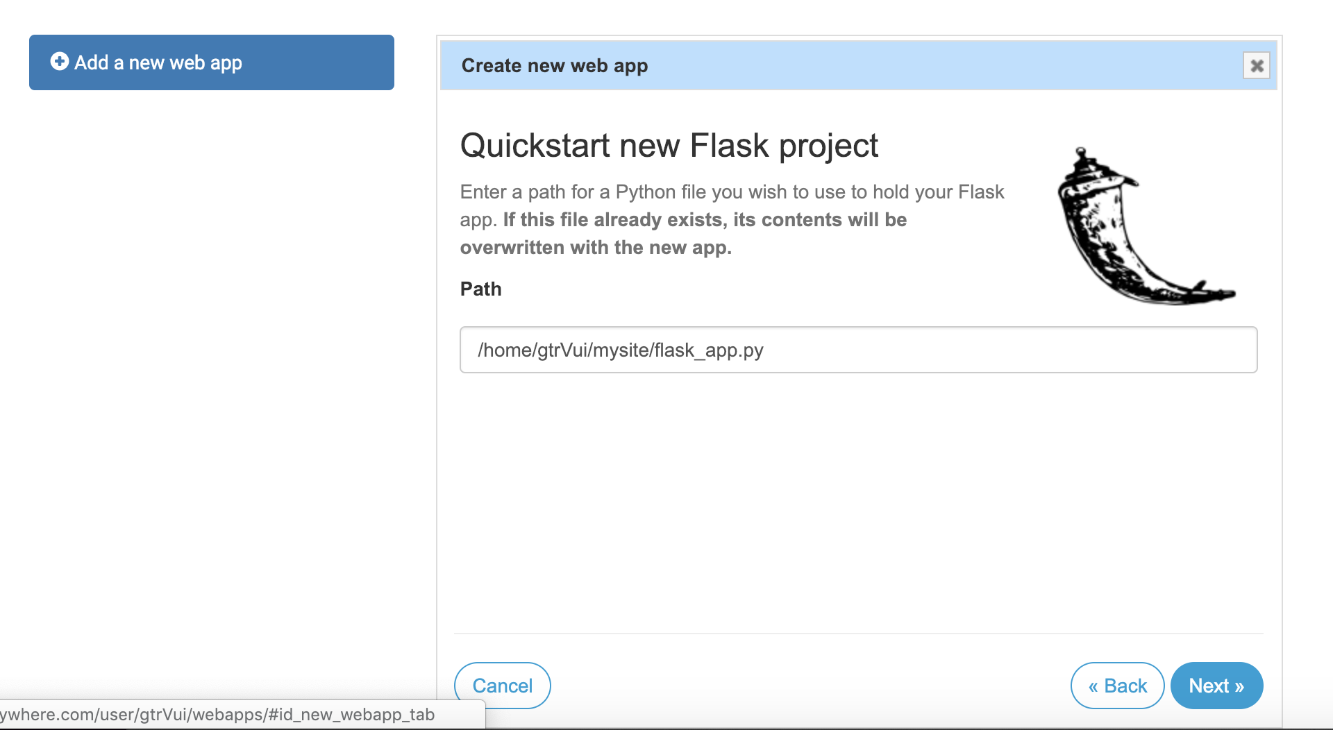
PythonAnywhere: App Creation

Slide 32
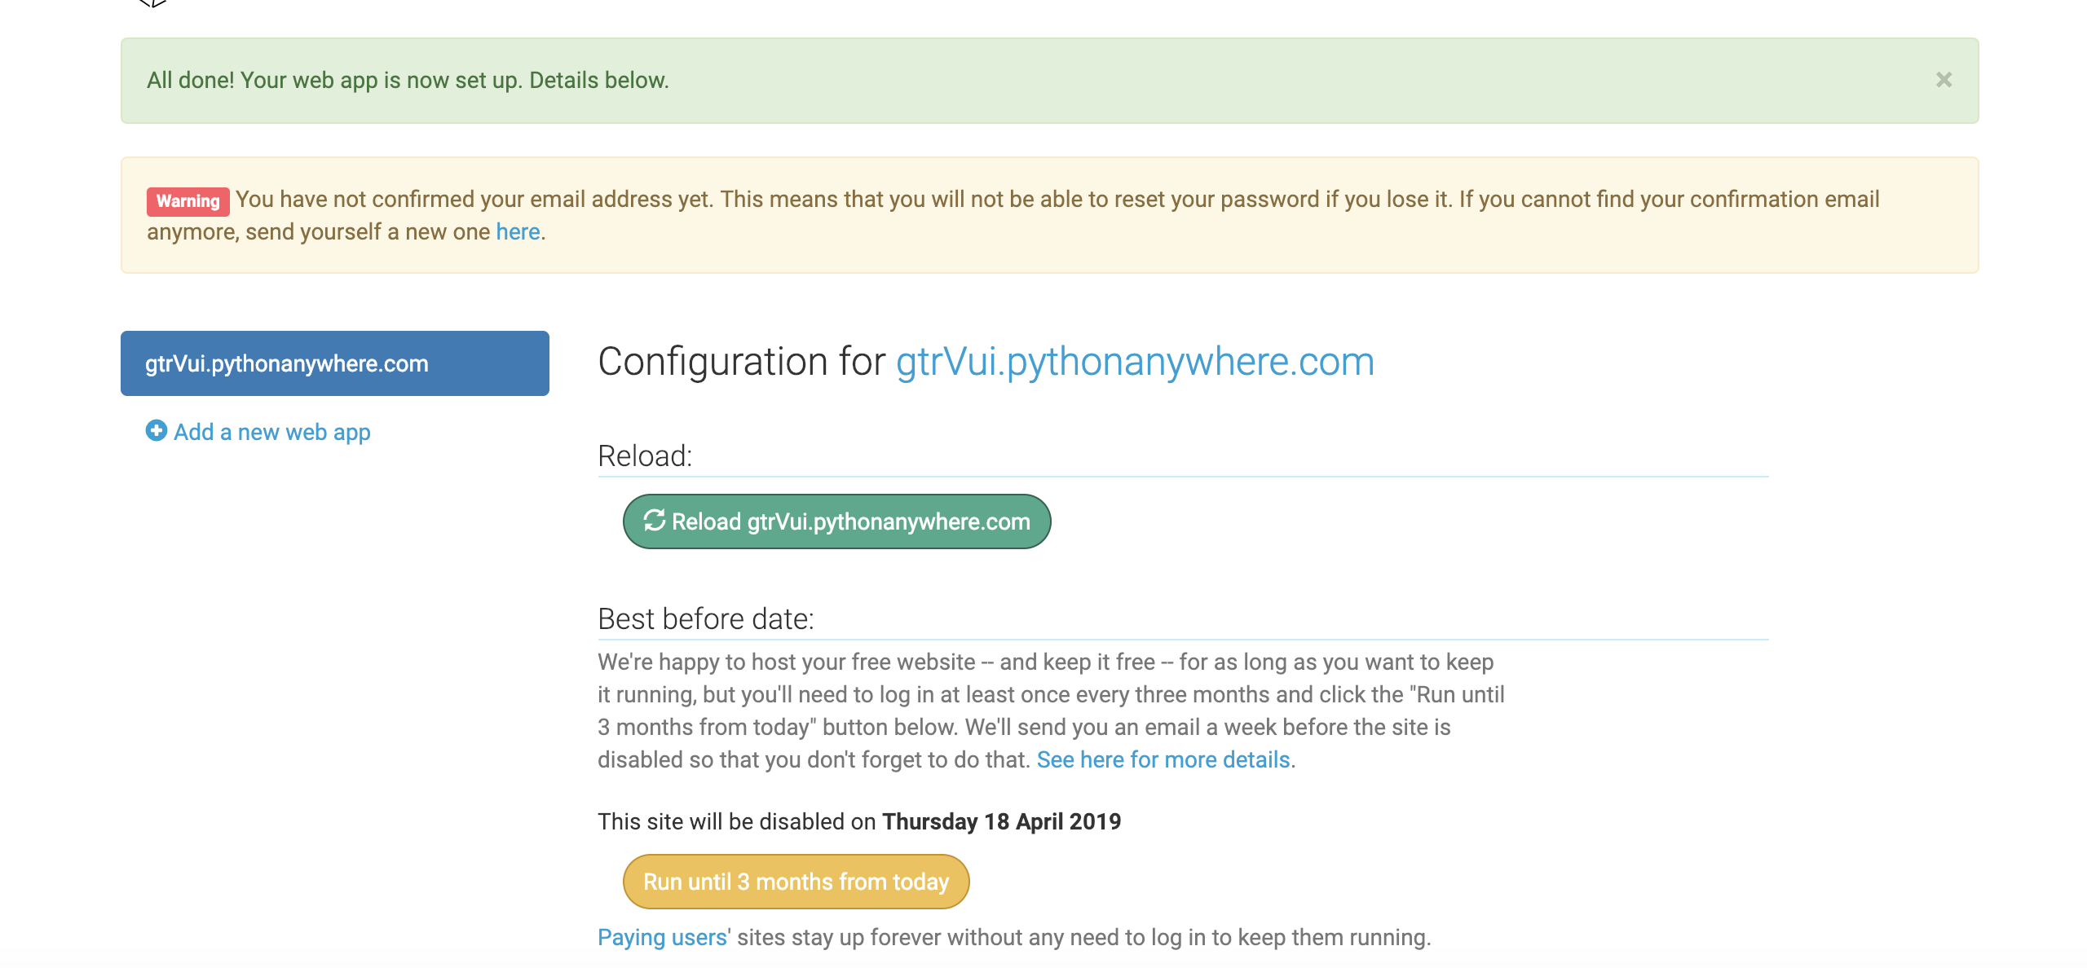
PythonAnywhere: App Creation

Slide 33
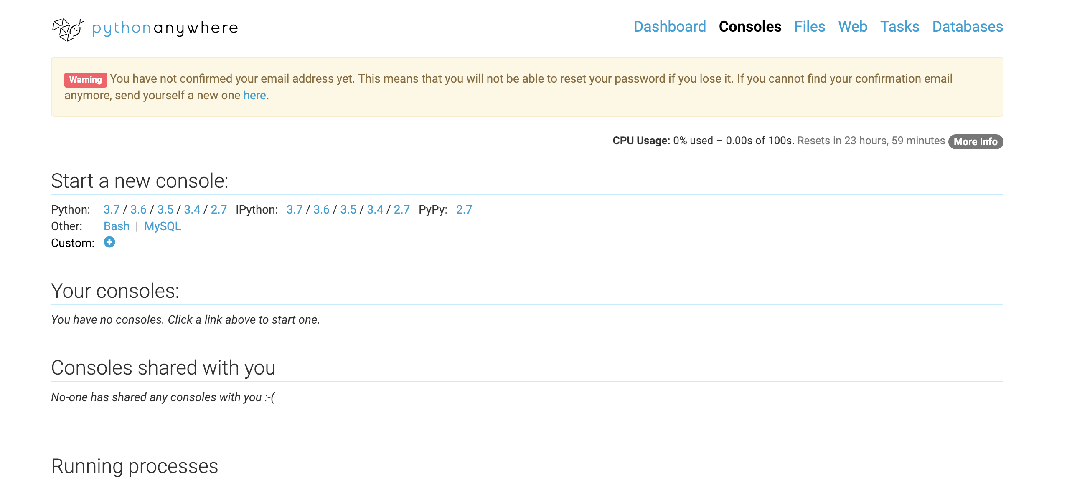
PythonAnywhere: Console

Slide 34
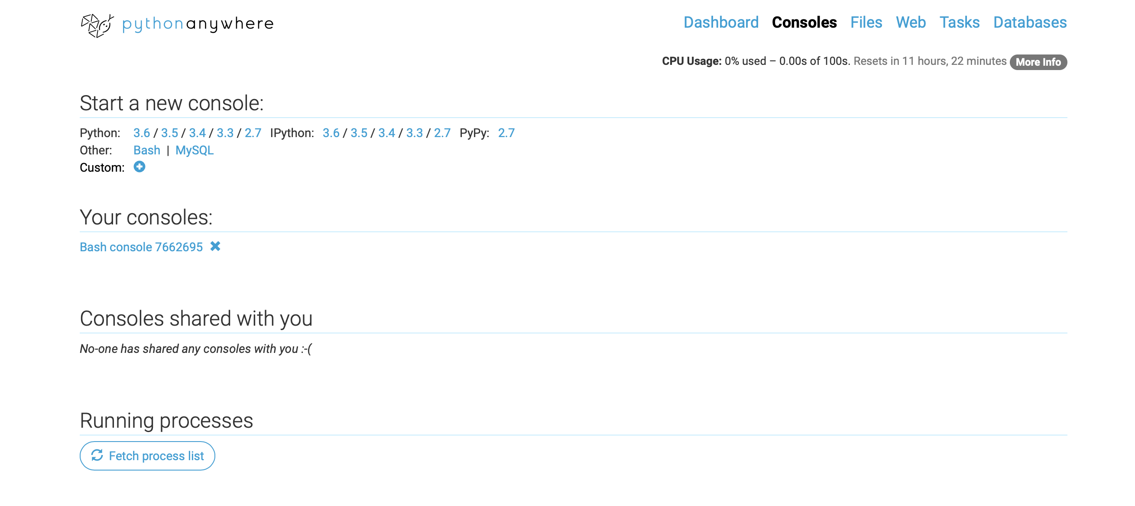
To deploy
Go to console, create a new one if needed
Run the following commands to set up the env and install code
virtualenv -p python3.6 alexa_lab_venv source /home/giulianTrt/alexa_lab_venv/bin/activate pip install flask-ask pip install cryptography==2.1.4 git clone https://github.com/giTorto/alexa_lab.git
*pip install git+https://github.com/johnwheeler/flask-ask.git

Slide 35
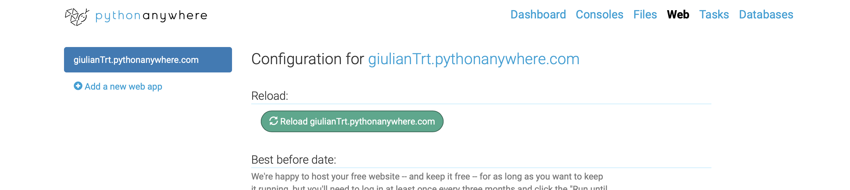
Set up the web hook

Slide 36
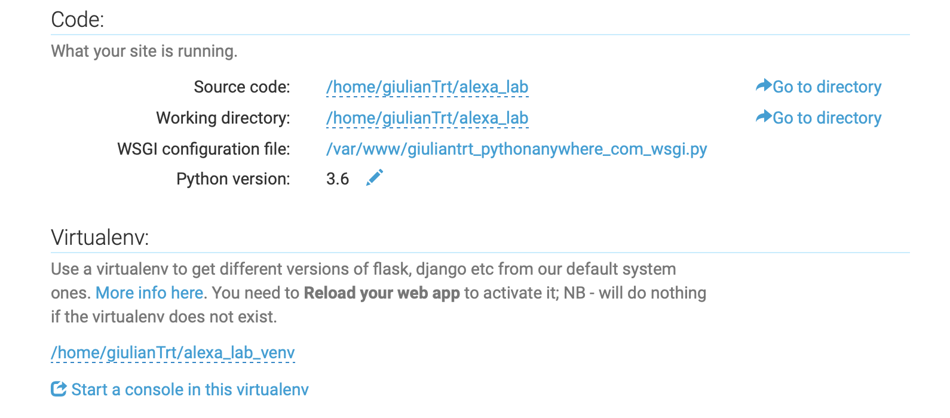
Set up the web hook

Slide 37
Set up the web hook
Edit venv:
/home/giulianTrt/alexa_lab_venv
Edit the working directory:
/home/giulianTrt/alexa_lab/pt1_basic_skill
Edit the source directory:
/home/giulianTrt/alexa_lab/pt1_basic_skill
Edit the wsgi:
/var/www/giuliantrt_pythonanywhere_com_wsgi.py
from alexa_app import app as application

Slide 38
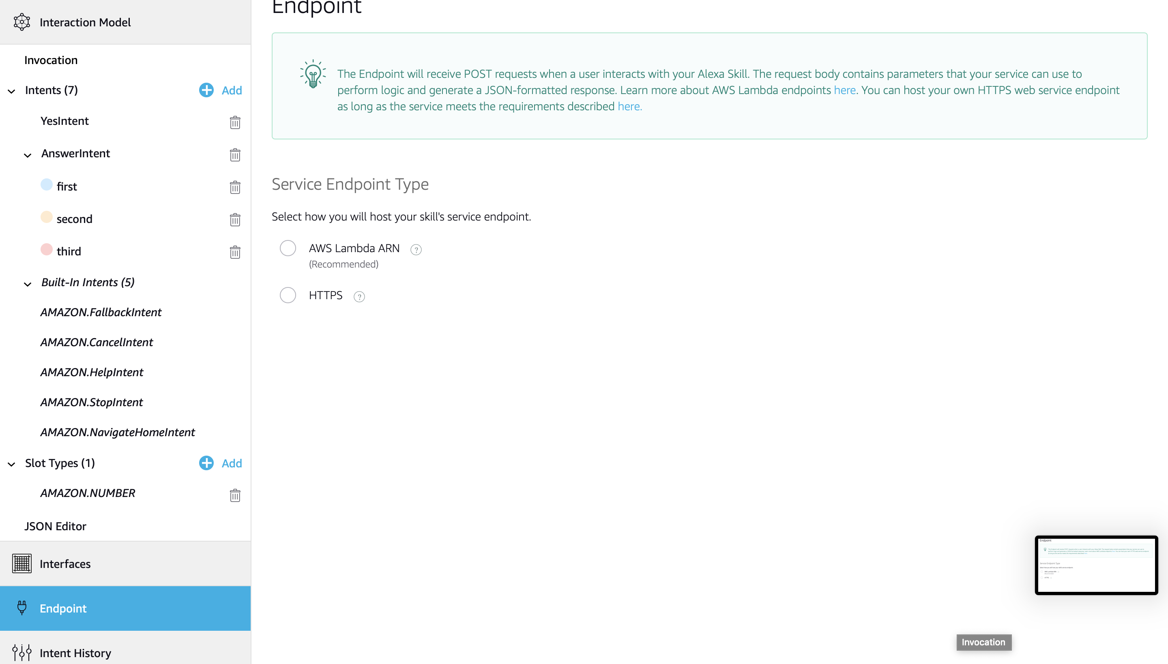
Back to ASK console
Set up the endpoint on alexa skill endpoint: https://giulianTrt.pythonanywhere.com/

Slide 39
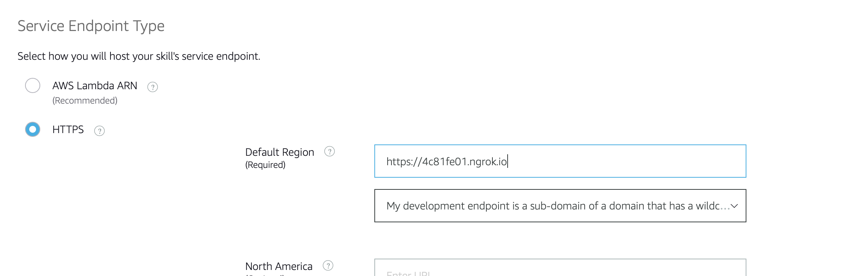
Set up the Endpoint
With ngrok never add a trailing /, but with pythonanywhere it’s needed:
https://giulianTrt.pythonanywhere.com/

Slide 40
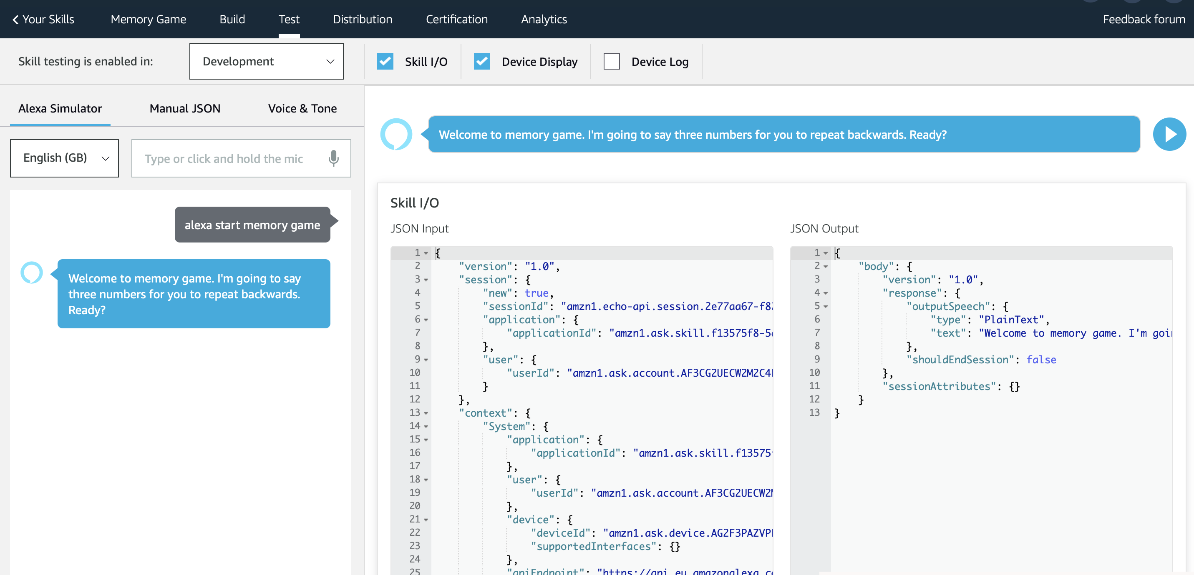
Let’s test

Slide 41
Completed set up for a basic Skill
What did we build?
NoIntent is not even in the intent schema
What should happen if user says No?

Slide 42
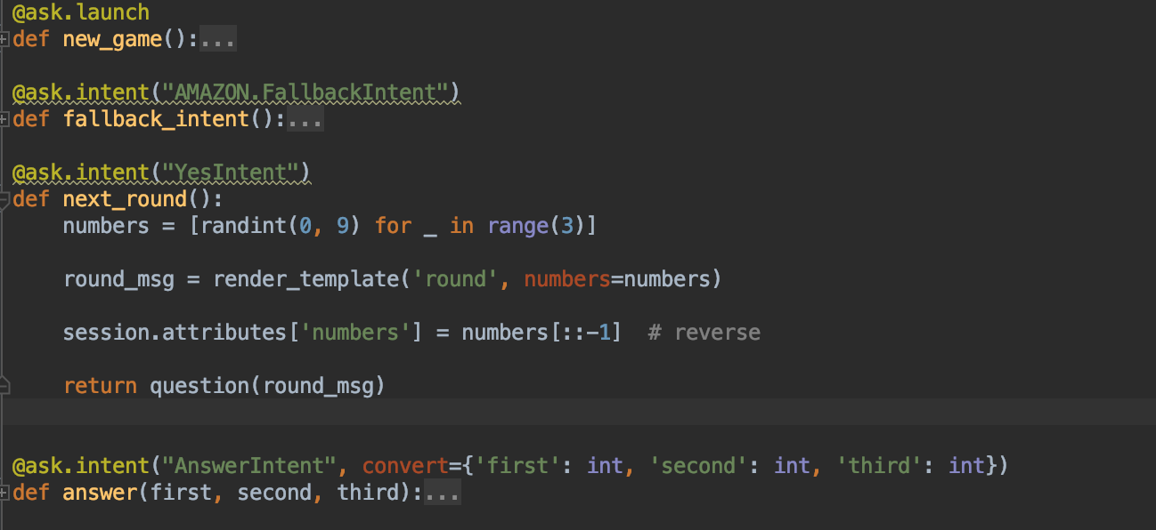
How is done in Flask-Ask

Slide 43
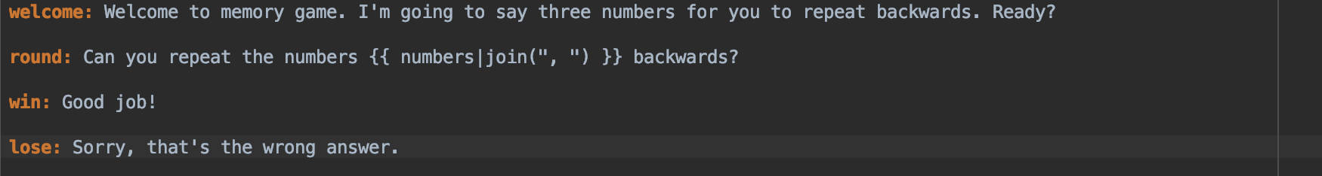
What is a template?

Slide 44
Exercise 1:
The current skill doesn’t have a
NoIntent
Add a NoIntent to your Skill
Add some business logic to handle it
Deploy (simplest way is to update the repository and pull from PA)

Slide 45
That’s all you need for Setting up a basic Skill

Slide 46
Improve your Skill
Next steps :
Slot Customisation
Context Management
Template customisation
Memory Game is to easy… Let’s move to restaurant booking
https://github.com/giTorto/alexa_lab/tree/master/pt2_slots_and_context

Slide 47
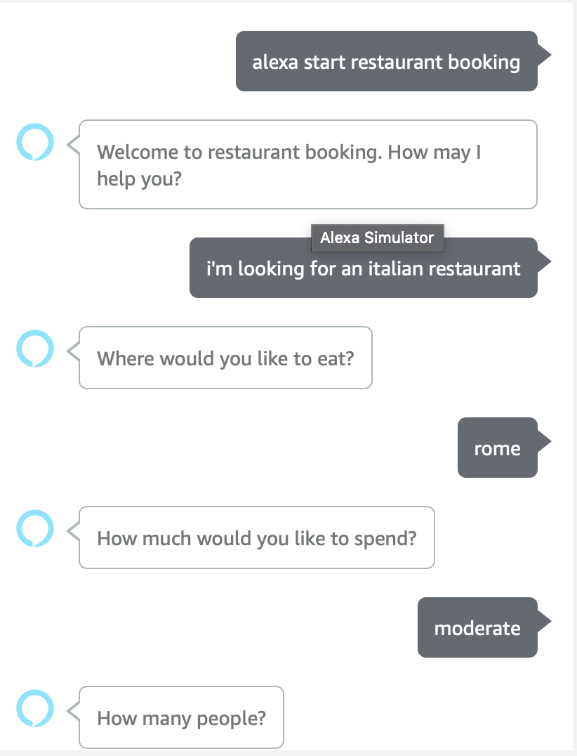
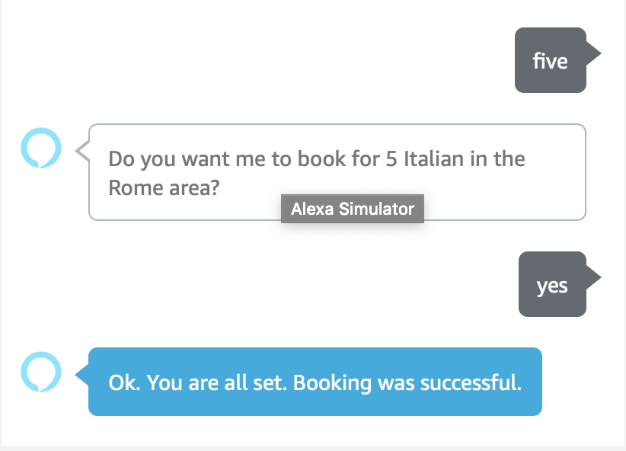
Restaurant booking

Slide 48
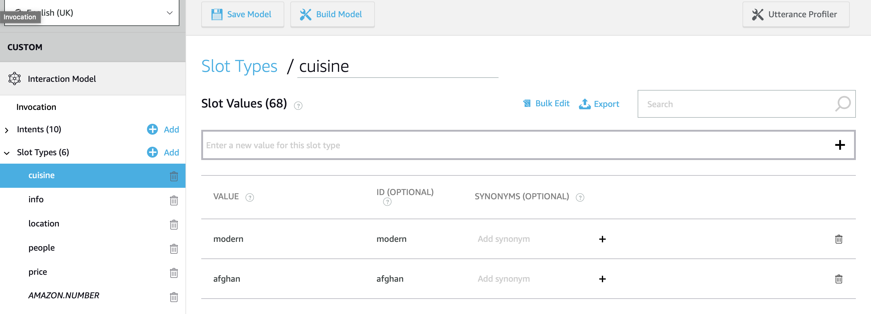
Slot Customisation (UI way)

Slide 49
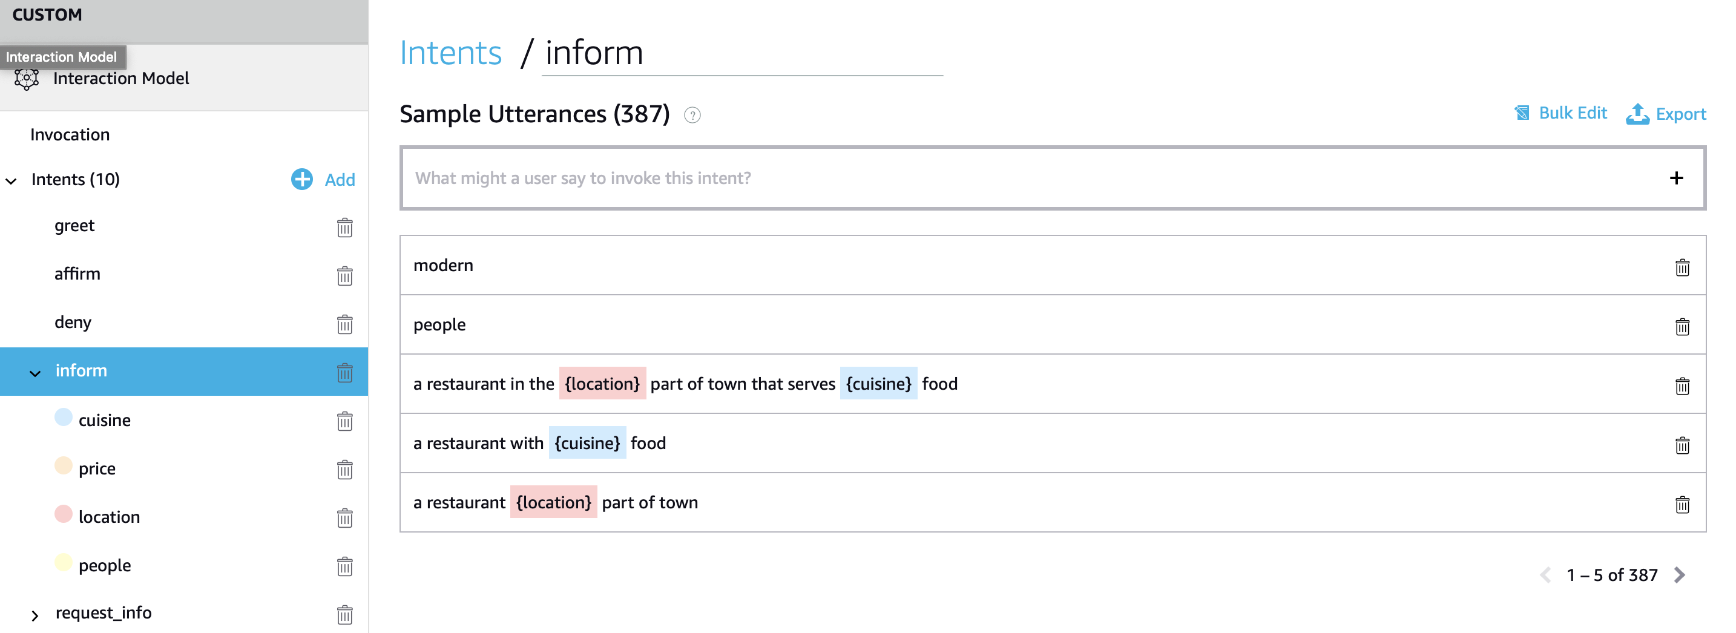
Slot Customisation (UI way)

Slide 50
Exercise 2
Create an Alexa Skill called “Restaurant Booking”
Add custom slots: (use bulk edit and take files from here)
CUISINE
INFO
LOCATION
PRICE
Add intent (use bulk edit and take samples from here):
Inform

Slide 51
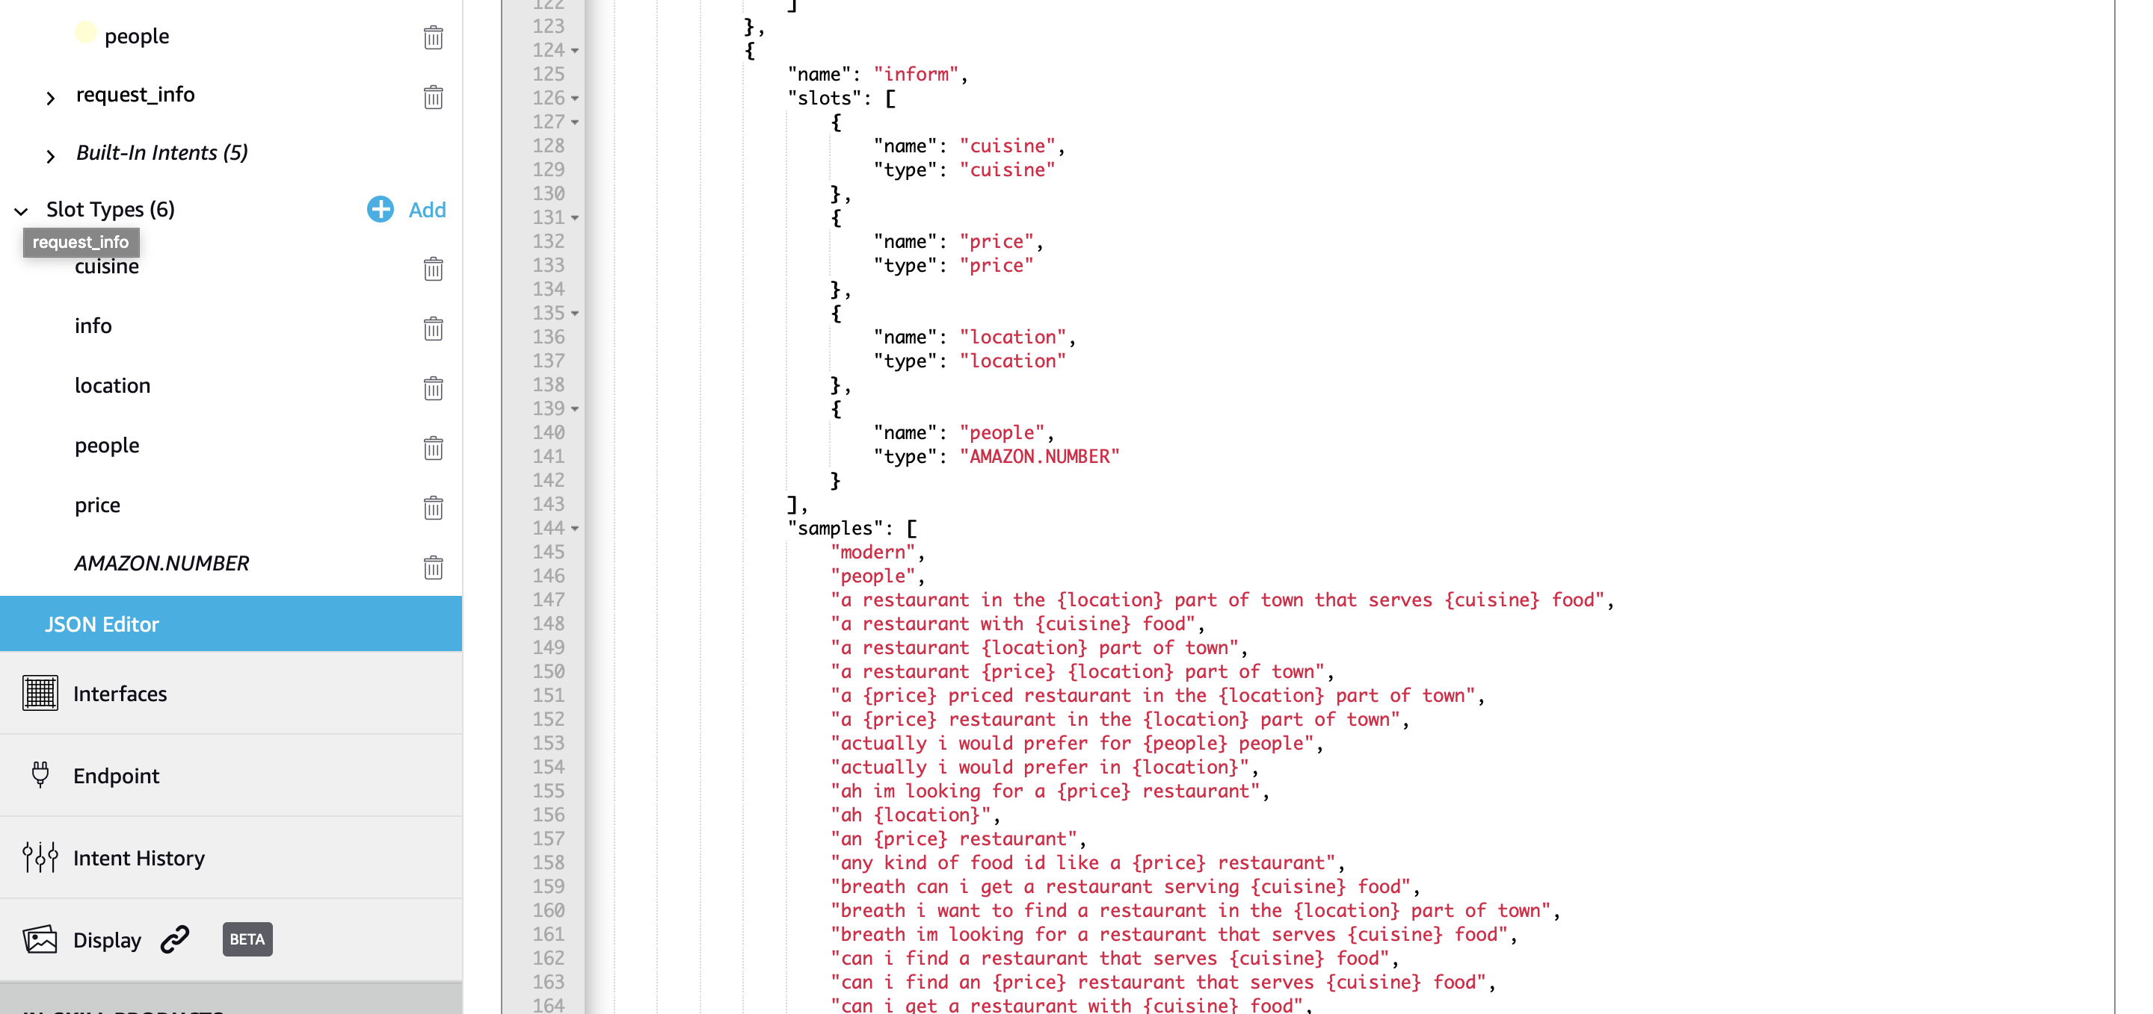
JSON Editor way (copy paste from here)

Slide 52
Exercise 3
Set up the restaurant booking endpoint in ASK
Deploy on pythonanywhere updating what’s needed
Test

Slide 53
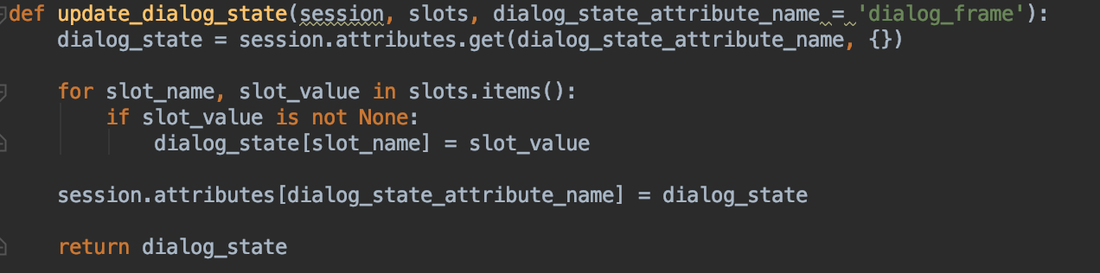
Restaurant Booking: context management
Session attributes are passed back and forth to the Web Server
Storing attributes in session

Slide 54
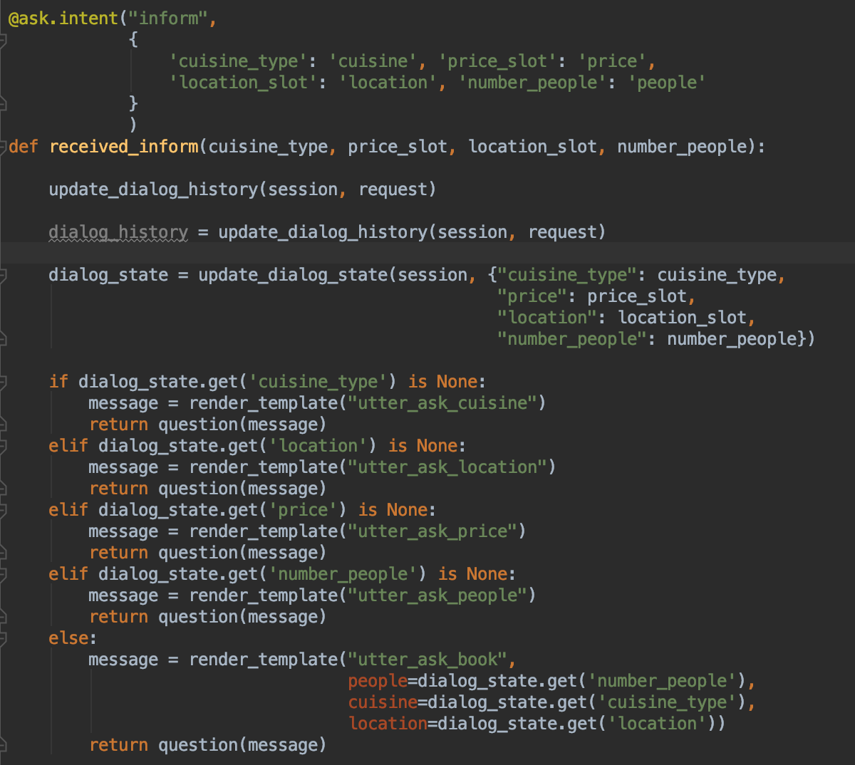
Using Context

Slide 55
Statement vs Question
Response returned must be wrapped
Statement: session gets closed
Question: session remain open

Slide 56
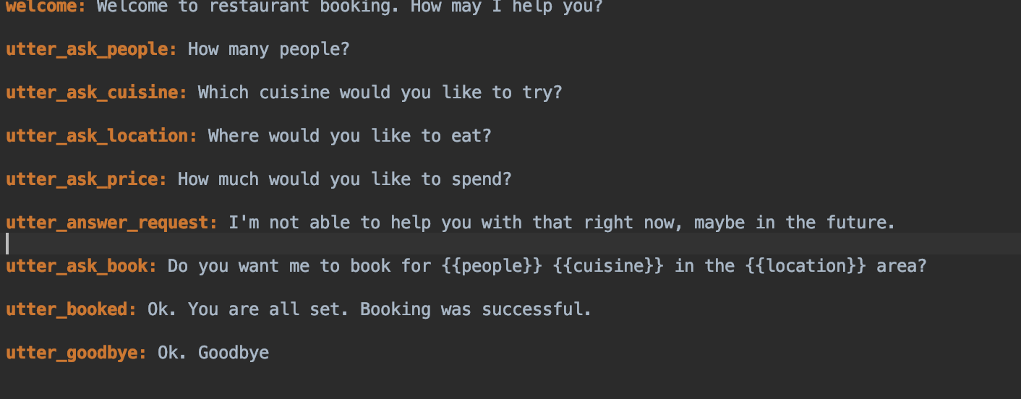
Templates can be customised

Slide 57
Exercise 4
As of now when ”deny” intent is received the system goes to goodbye
Change the dialog logic such that the system asks if the user wants to try a new booking
If the user confirms, reset the context and restart with the initial interaction
Update & deploy

Slide 58
That’s all you need build a skill with context

Slide 59
Multimodality: Directives and APL
Directives
Screen displays must be enabled in Alexa Skill.
Templates are constructed to provide flexibility for the developer.
Each template has a JSON representation, and can be included in the skill responses sent to the screen.
Additional Intents need to be supported
Alexa Presentation Language (APL) (not covered in this lab)
Extended version of directives
Based on document definition

Slide 60
Directive types
BodyTemplate1
simple text and image views
BodyTemplate2
image views and limited centered text
BodyTemplate3
image views and limited left-aligned text
BodyTemplate6
text and optional background image
BodyTemplate7
for scalable foreground image with optional background image
ListTemplate1
text lists and optional
ListTemplate2
list images and optional text
Required fields defined here:
https://developer.amazon.com/docs/custom-skills/display-template-reference.html

Slide 61
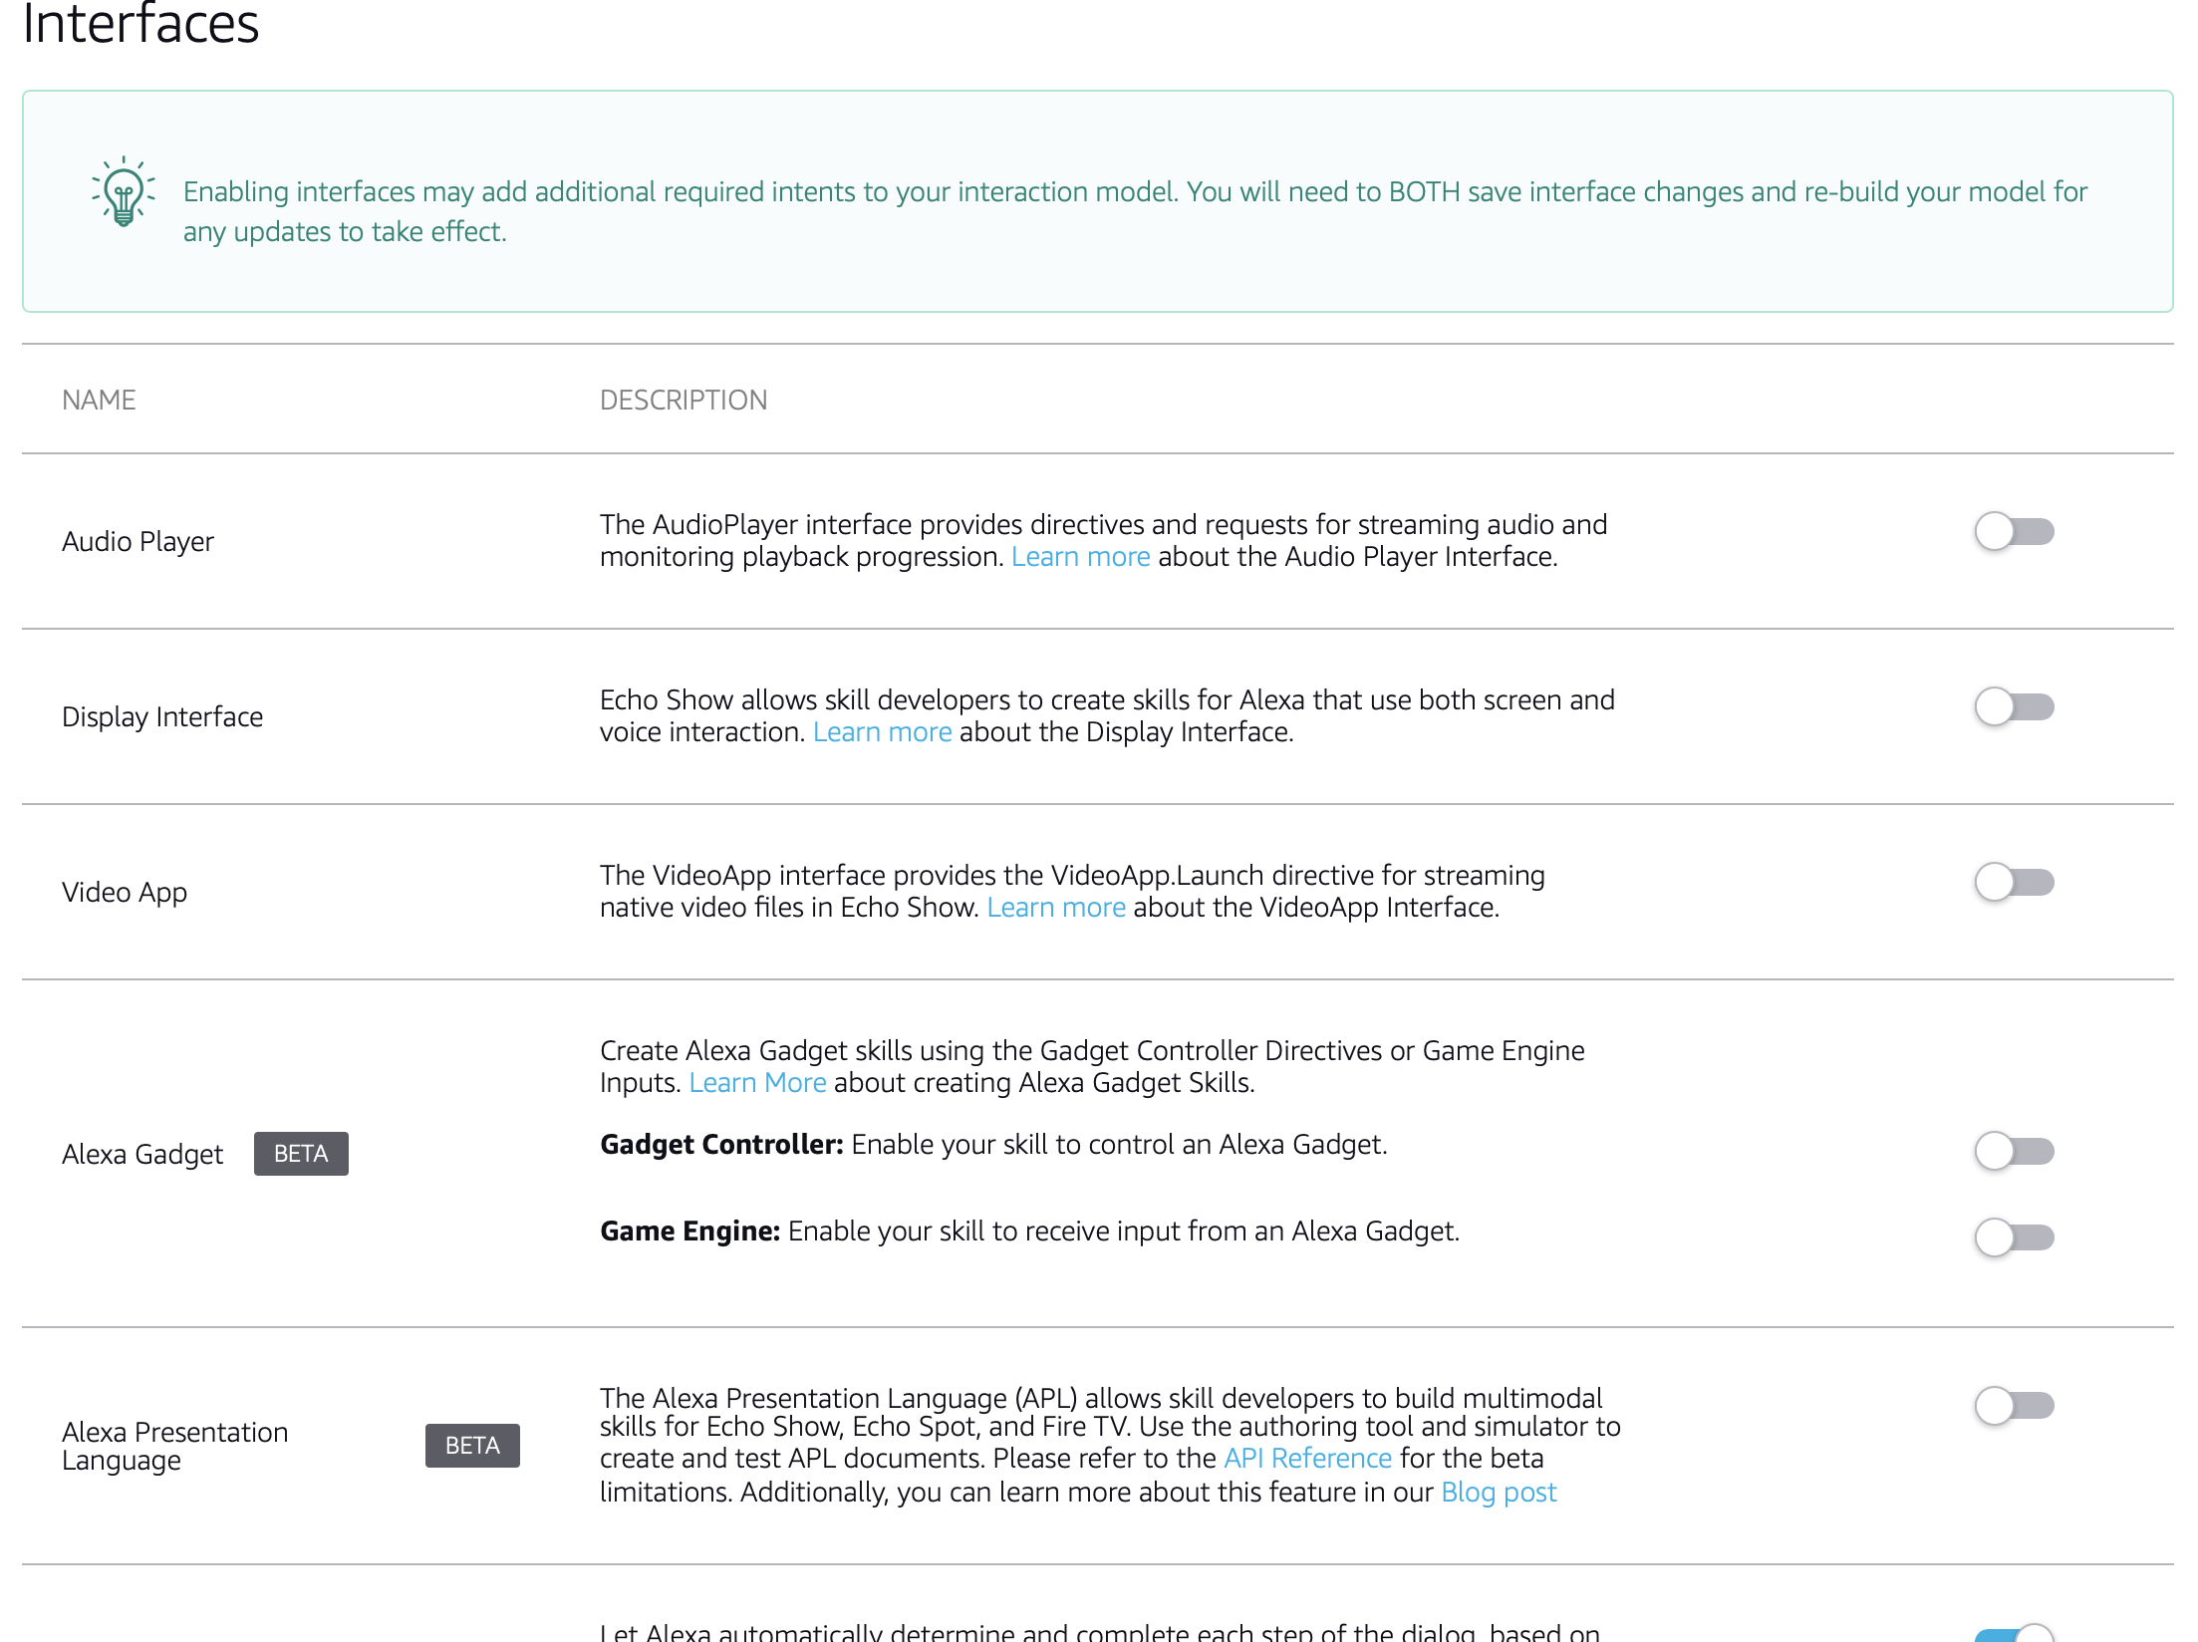
Enabling Display in Alexa Skill

Slide 62
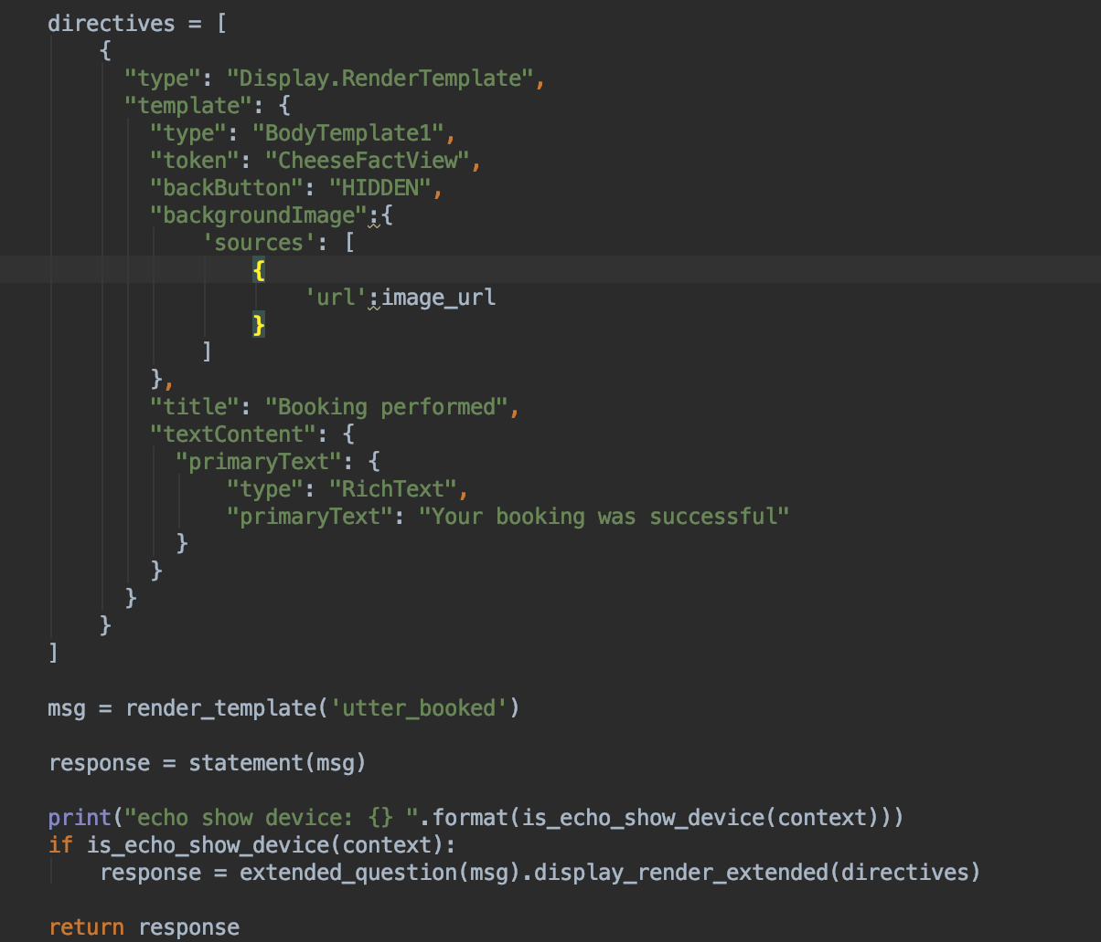
Directives representation: BodyTemplate1

Slide 63
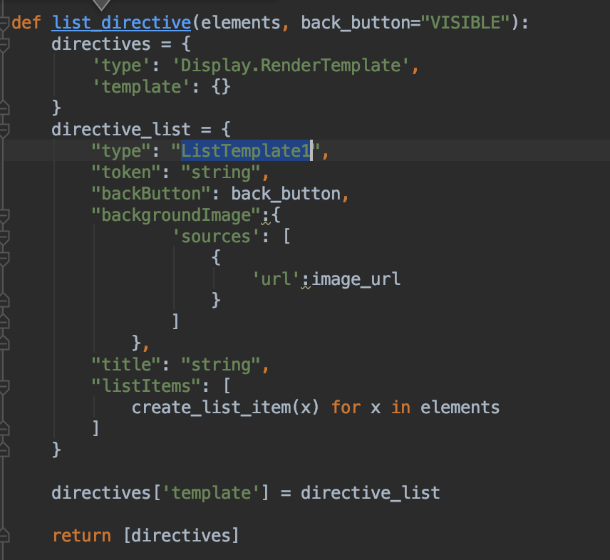
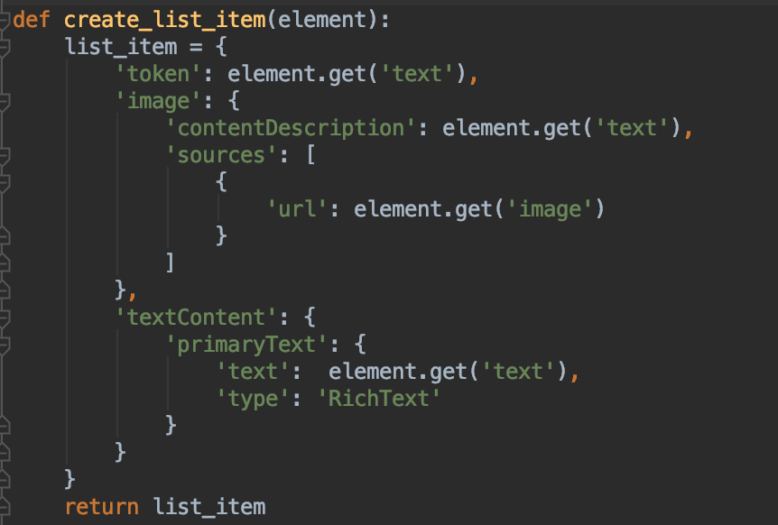
Directives Representation: ListTemplate1

Slide 64
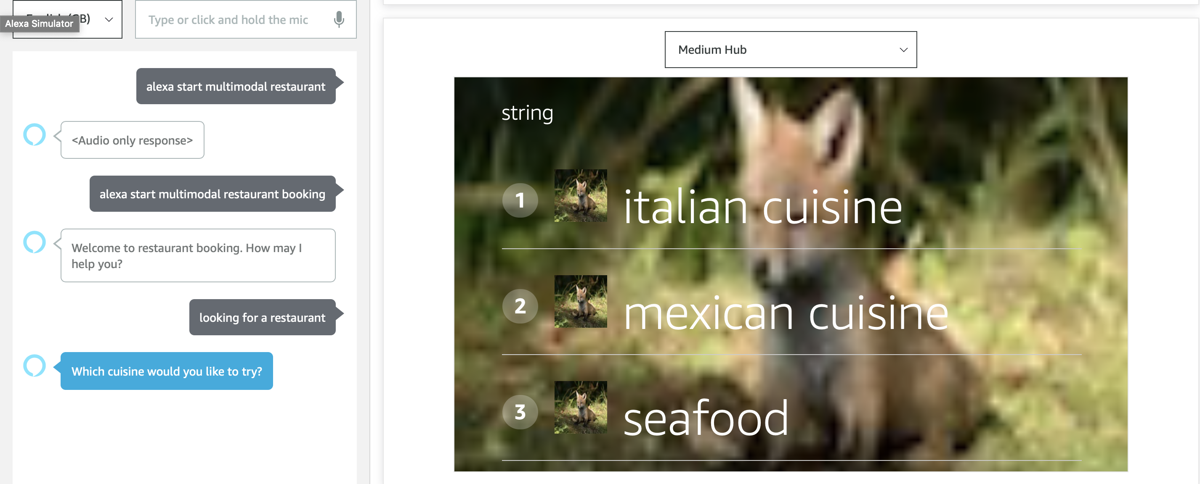
Example of Directive card

Slide 65
Exercise 6
https://github.com/giTorto/alexa_lab/tree/master/pt3_multimodality
Always restaurant domain
Task:
Create new skill
Enable directives in the Skill and Test
Add directives to additional prompts
Extend Flask App to support some directive-related intents
Test

Slide 66
Homework
Propose a Skill and implement it :D

Slide 67
Thank you

Slide 68
References
https://developer.amazon.com/blogs/post/Tx14R0IYYGH3SKT/Flask-Ask-A-New-Python-Framework-for-Rapid-Alexa-Skills-Kit-Development
https://developer.amazon.com/docs/custom-skills/create-and-edit-custom-slot-types.html
https://developer.amazon.com/blogs/alexa/post/2af6851b-0216-4e82-9aba-6fa2aec755d5/how-to-get-started-with-the-new-alexa-presentation-language-to-build-multimodal-alexa-skills
https://developer.amazon.com/docs/custom-skills/display-template-reference.html
https://developer.amazon.com/blogs/alexa/post/12826e9e-e06a-4ab4-a583-8e074709a9f3/how-to-build-alexa-skills-for-echo-show
https://developer.amazon.com/docs/custom-skills/display-interface-reference.html#full-json-response
https://developer.amazon.com/blogs/alexa/post/2af6851b-0216-4e82-9aba-6fa2aec755d5/how-to-get-started-with-the-new-alexa-presentation-language-to-build-multimodal-alexa-skills
https://developer.amazon.com/alexa/console/ask/displays
https://developer.amazon.com/docs/custom-skills/create-and-edit-custom-slot-types.html

